Slide 1


CAKE
Catching a kid excelling!

Slide 2
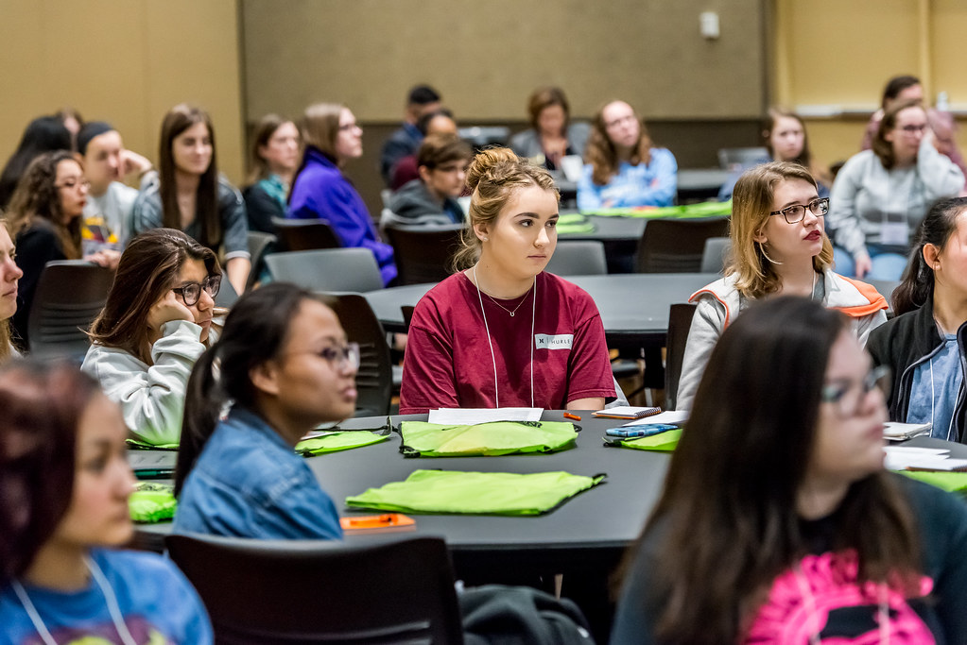
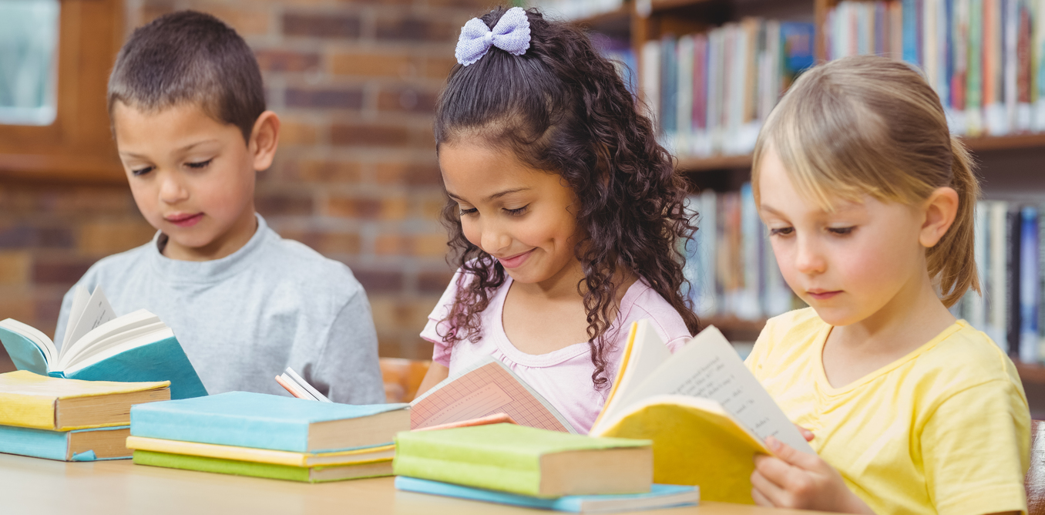
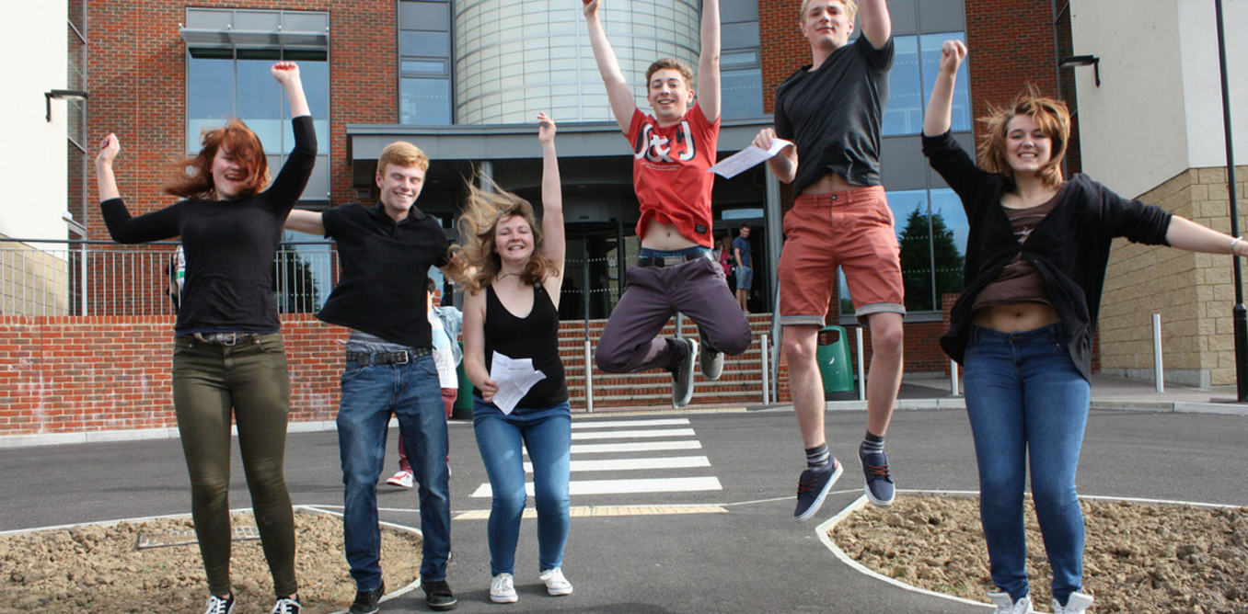
February 2025 CAKE students!

Slide 3
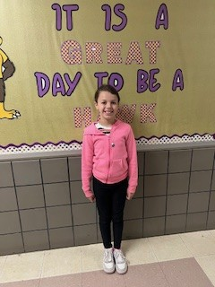
Braylee Moreno – Capon Bridge Elementary
Braylee was chosen because she is a pleasant student that always has a smile on her face. She is a very hard worker and gives it her all. She moved to Capon Bridge Elementary this year and has been soaring ever since. She is a great example of what a CAKE student should be!

Slide 4
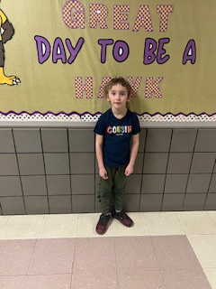
Lucian Doughty – Capon Bridge Elementary
Lucian was chosen because he has shown tremendous academic and personal growth. In Math, he displayed good quantitative skills and is a whiz at counting patterns and addition and subtraction concepts. He continually strives to improve his reading and phonemic abilities. He has also worked on his attention and focus skills. He is a polite young man who is always willing to help and share with others. He is a phenomenal artist as well!

Slide 5
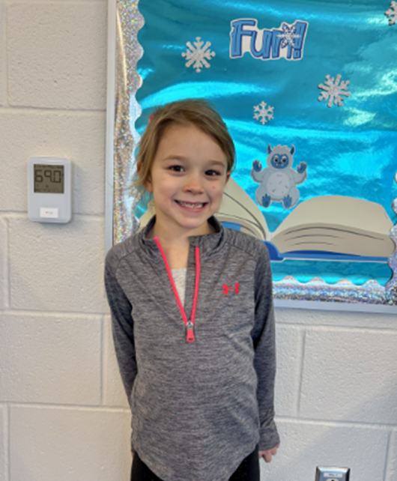
Layken Caldwell – Ice Mountain Elementary School
Layken is an exceptional first grade student at Ice Mountain Elementary. She works very hard on all assignments given. She is outgoing and always willing to lend a hand. She asks her teachers multiple times throughout the day if she can help. At recess, she looks for people who may need a friend and asks them to play. Her kindness radiates throughout the school. Layken enjoys playing organized soccer outside of school and participates in gymnastics. She is a well-rounded student who is outstanding!

Slide 6
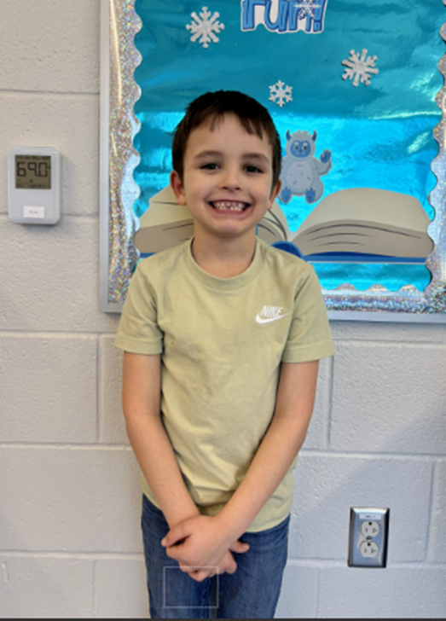
Jayce Toomey – Ice Mountain Elementary School
Jayce is a hard-working first grader at Ice Mountain Elementary. His joyous personality and ability to overcome are just a few of his positive characteristics. He has a never give up attitude towards classroom work and sports. He enjoys every sport at recess and is a delight to watch. Jayce is resilient and is always encouraging other students to do their best. Outside of school, you may find him playing football with his teammates. Jayce is a positive leader for anyone around him!

Slide 7
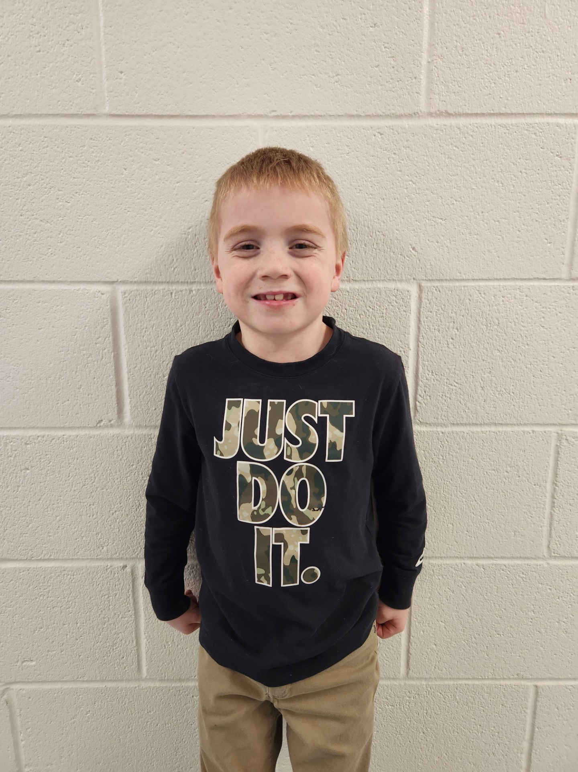
Colton Hines - Windy Ridge
Colton was chosen because of his recent work with his behavior. He has been working very hard to improve his behavior and show what a model Windy Ridge Honeybee can and should be. He has made improvements not only in the classroom, but in the small group setting as well with other teachers. They have praised him for his hard work and he continues to shine!

Slide 8
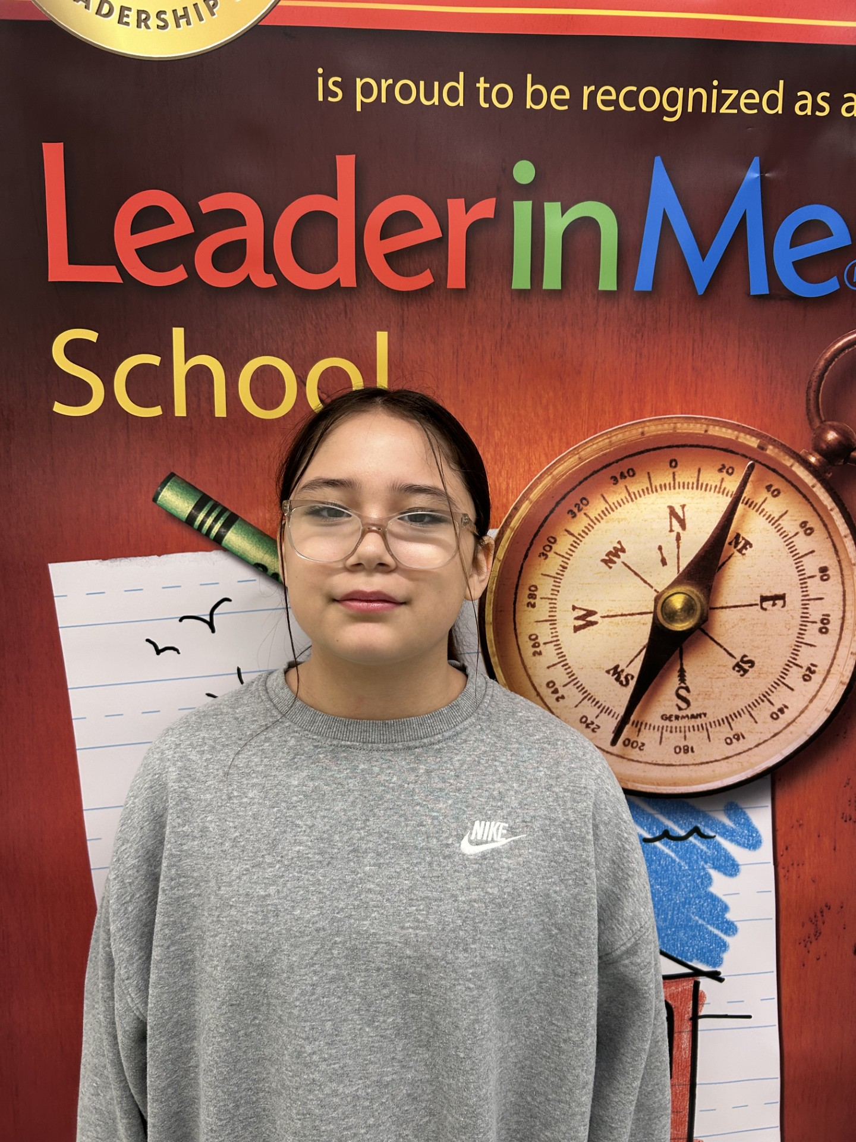
Alanna Valle – South Branch Elementary
Alanna Valle is a prime example of what to look for in a CAKE student. Alanna takes pride in her learning and understands the importance of creating a learning environment for her classmates as well. She is a good friend to others. She is inclusive with all her classmates and shows maturity and empathy in situations that many students her age struggle with. Alanna strives to do her best on her assignments and asks for help and guidance when necessary. She has shown great leadership skills in the classroom—helping others when needed and helping me when I need it, too! I can't wait to see how Alanna continues to grow and put all of these amazing qualities to use as she moves into her teenage years and adulthood. Way to go, Alanna! I am very proud of the person you are!

Slide 9
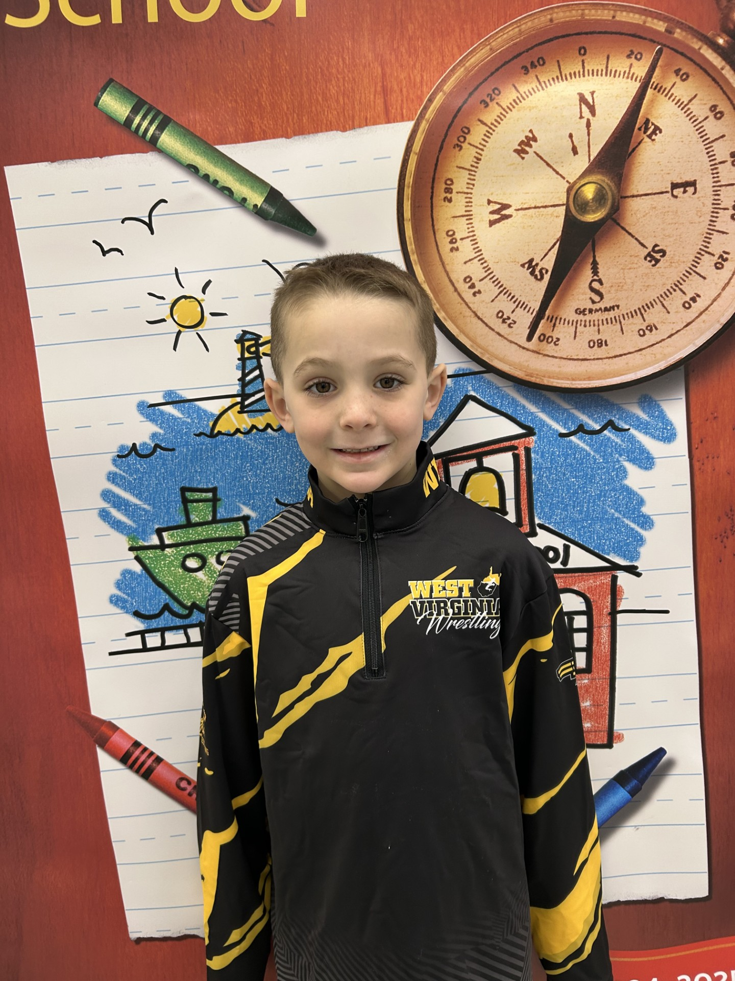
Nathan Kesner – South Branch Elementary
Nathan is a pleasure to have in class and is a fantastic student! He is a very kind classmate. He is willing to help his teachers and peers when he notices they are in need. He has a positive attitude and comes to school happy and ready to learn. He actively participates in class discussions. He works hard and is dedicated to learning.

Slide 10
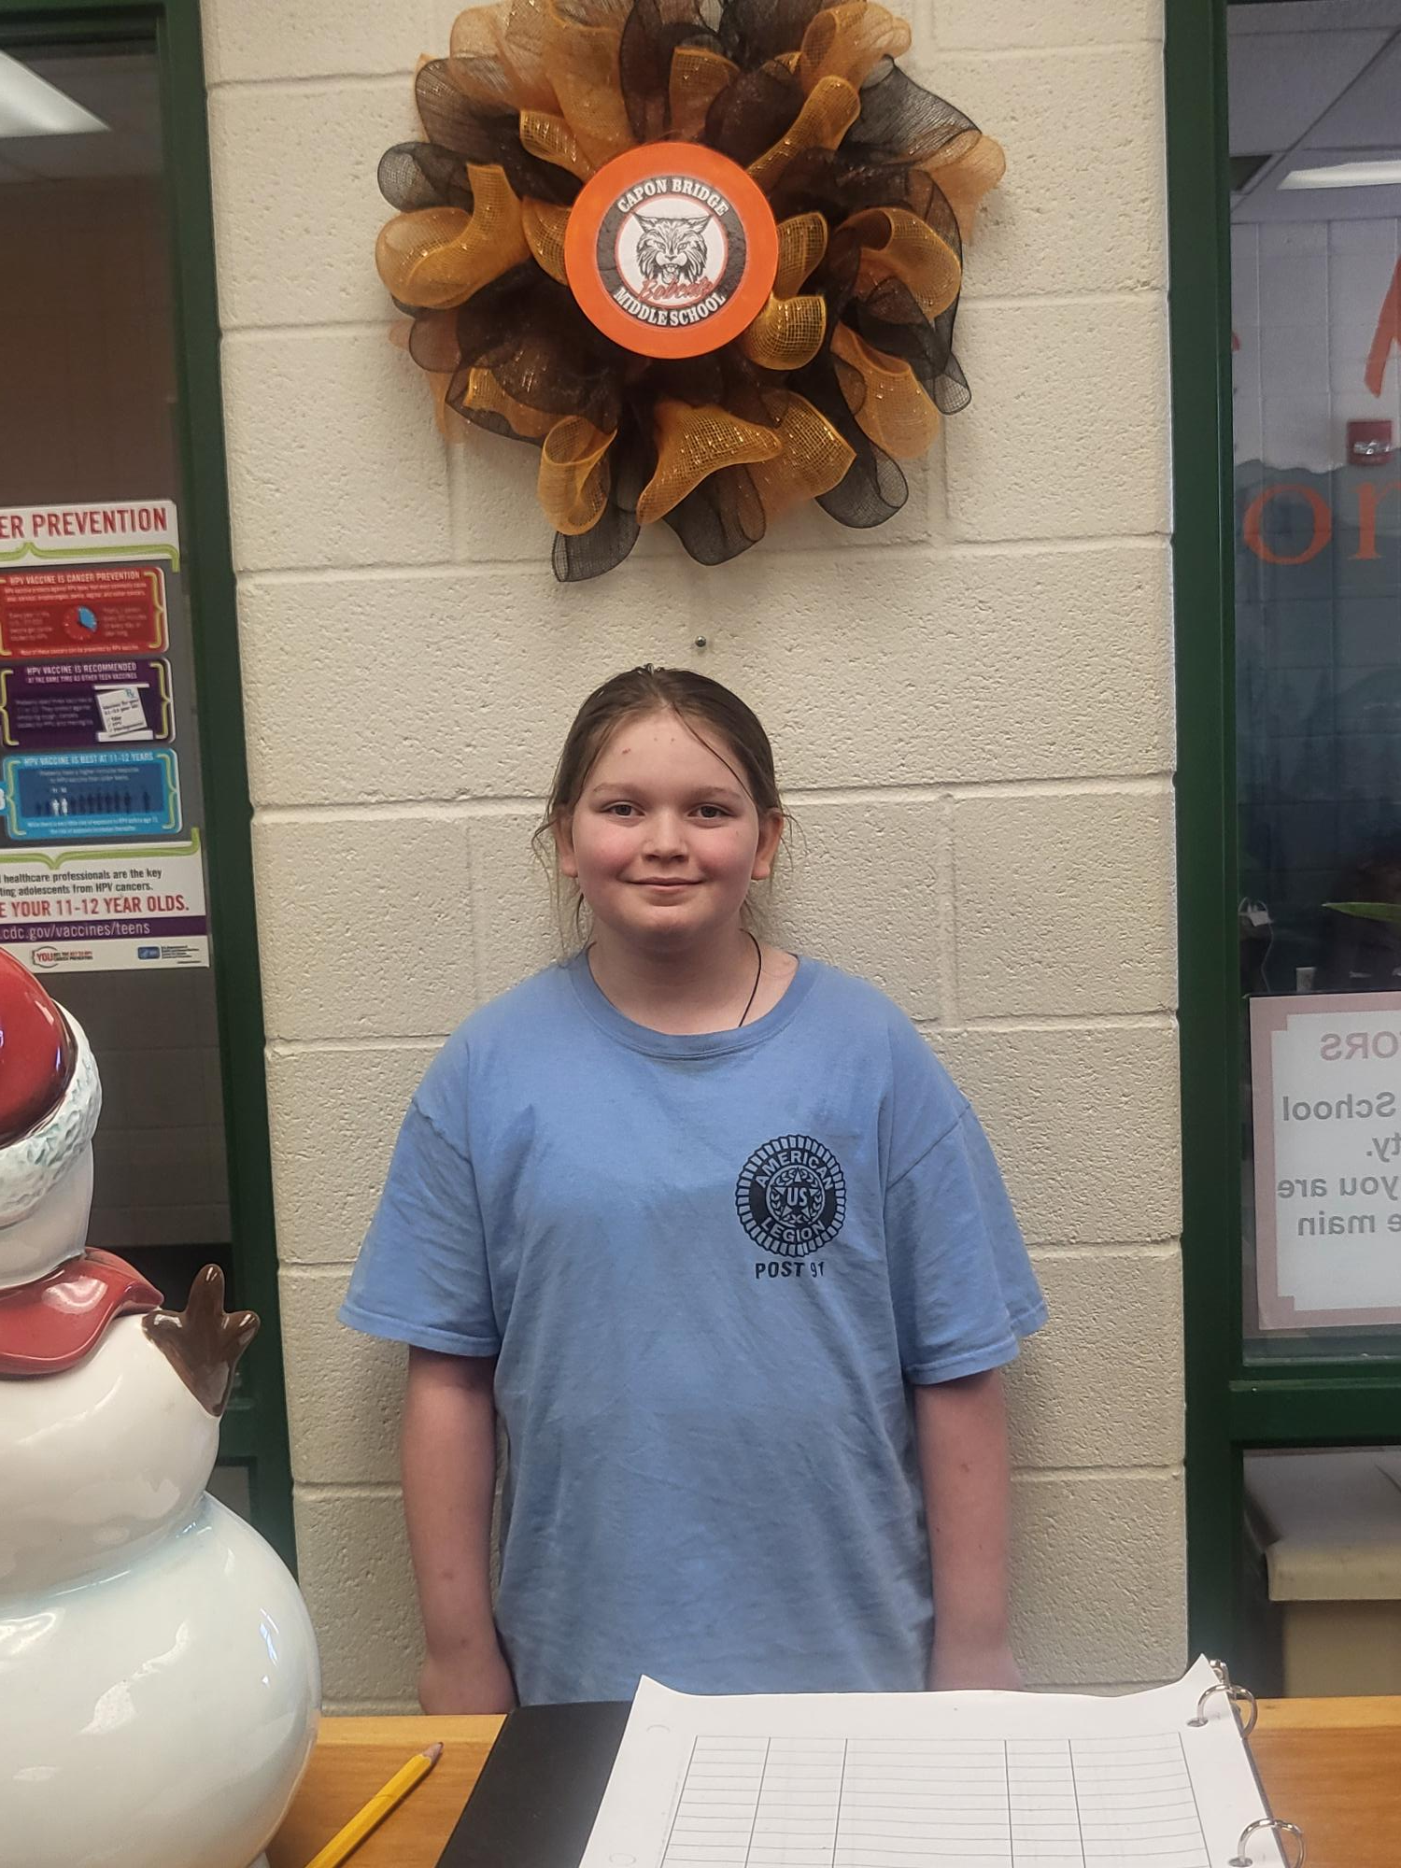
Brooklyn Kline – 6th Grade Capon Bridge Middle School
Brooklyn has consistently demonstrated dedication, kindness and leadership in and out of the classroom. She is always willing to help others, stays focused and respectful and puts forth her best efforts in her schoolwork. As an Attendance Ambassador and Teacher Assistant in her homeroom, she leads by example and ensures a positive, productive environment for her peers. Her hard work, positive attitude and commitment to excellence make her truly deserving of this recognition!

Slide 11
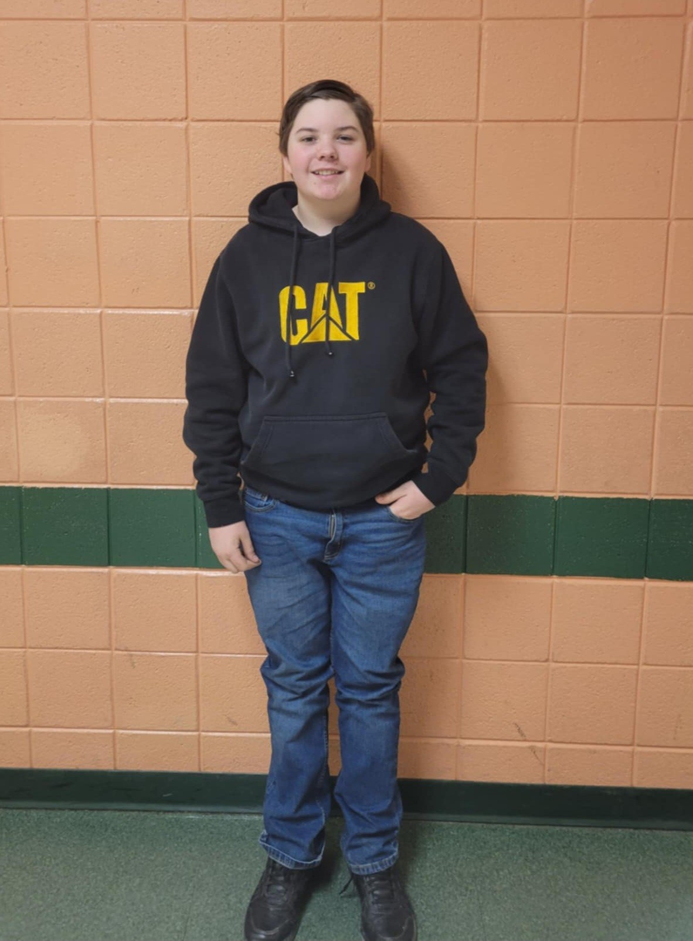
Bradley Bohrer – 7th Grade Capon Bridge Middle School
Bradley is conscientious, gets along well with his peers and works well with others.

Slide 12
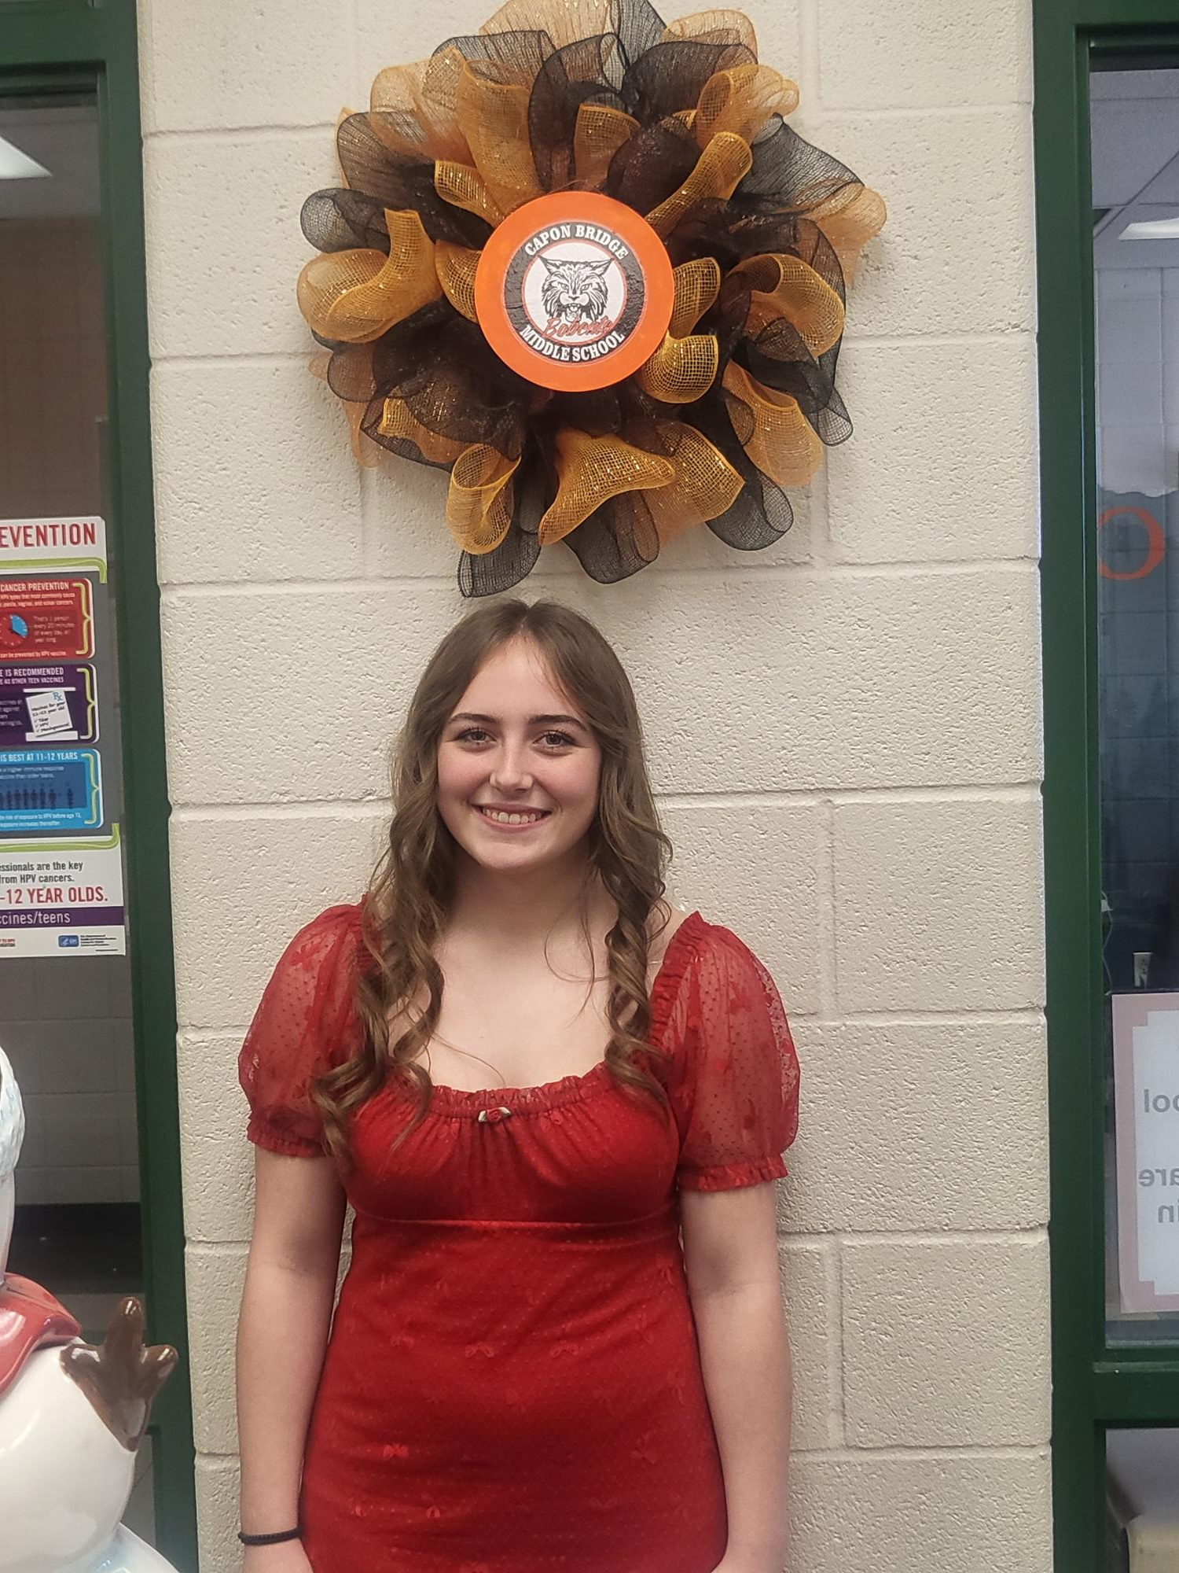
Riley Kerns – 8th Capon Bridge Middle School
Riley is a student that takes pride in being a Bobcat through sports, academics and through interacting with others. She makes a point to motivate others to bring their Bobcat best in all given situations. She handles her business, puts her best effort forward in all that she does and she is a PAWsome pal to those around her in her friend group, teammates and classmates. Keep up the great work, Riley!

Slide 13
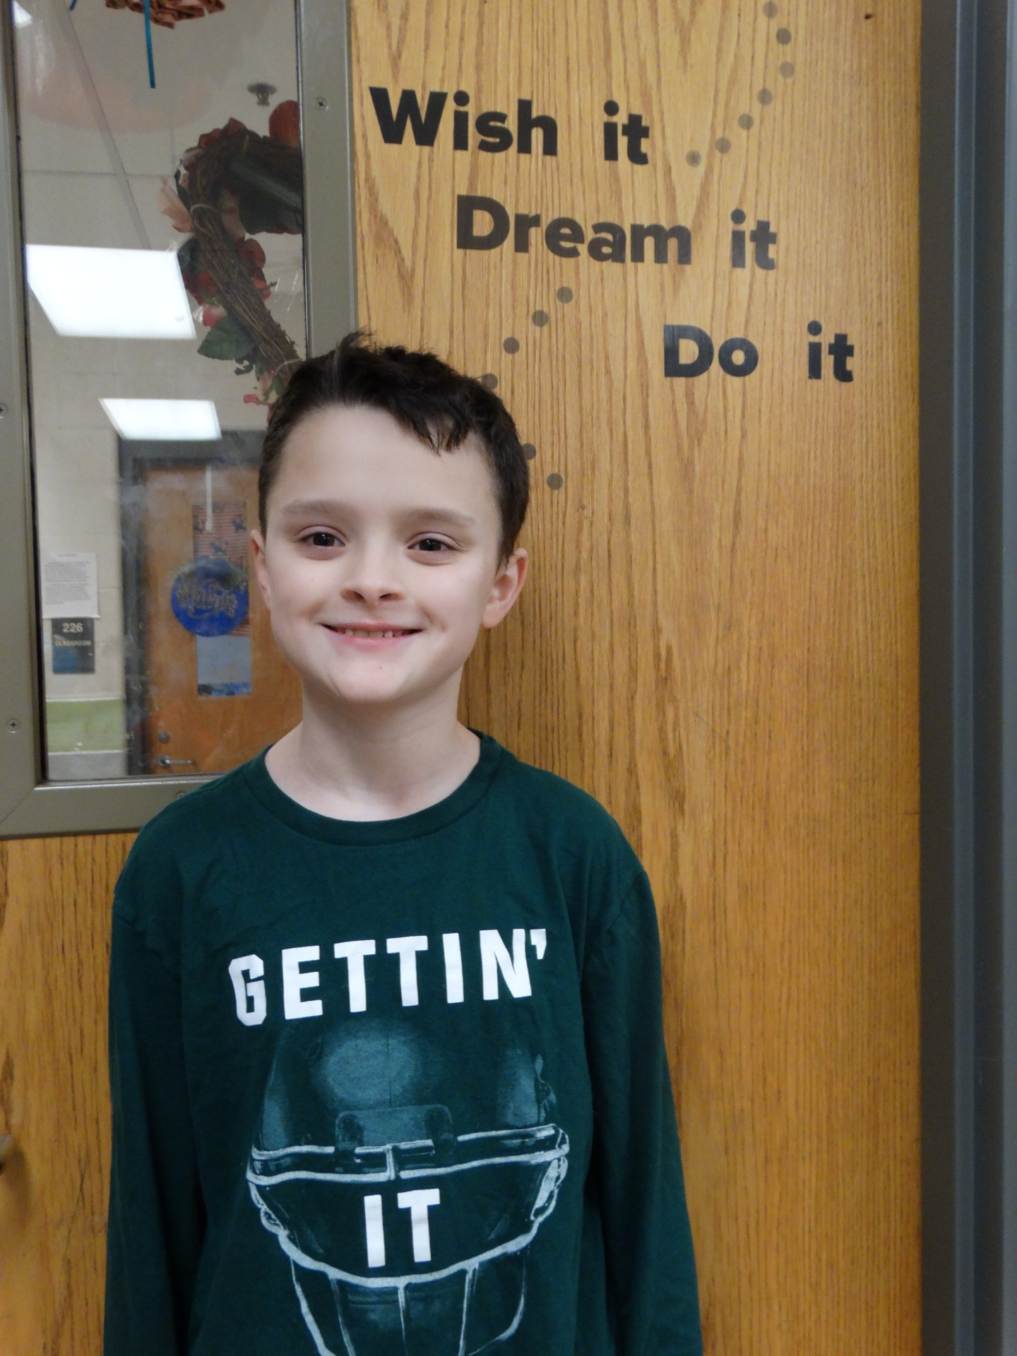
Cameron Mosholder – 6th Grade Romney Middle School
Cameron was selected because of his conscientiousness. He is a hard-working self-starter who always tries to do his very best no matter what the subject or how tough the job. He goes out of his way to help others. He is kind and respectful to everyone!

Slide 14
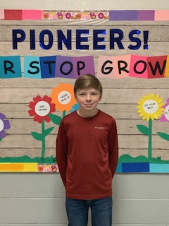
Charlie Ruckman – 7th Grade Romney Middle School
Charlie was chosen because he is respectful, kind and well-mannered. He is never disruptive and is an ideal student for any teacher or staff member to have in class. He is a conscientiousness student who always strives to do his best. He also has excellent attendance. Charlie is an outstanding example of what a CAKE student represents.

Slide 15
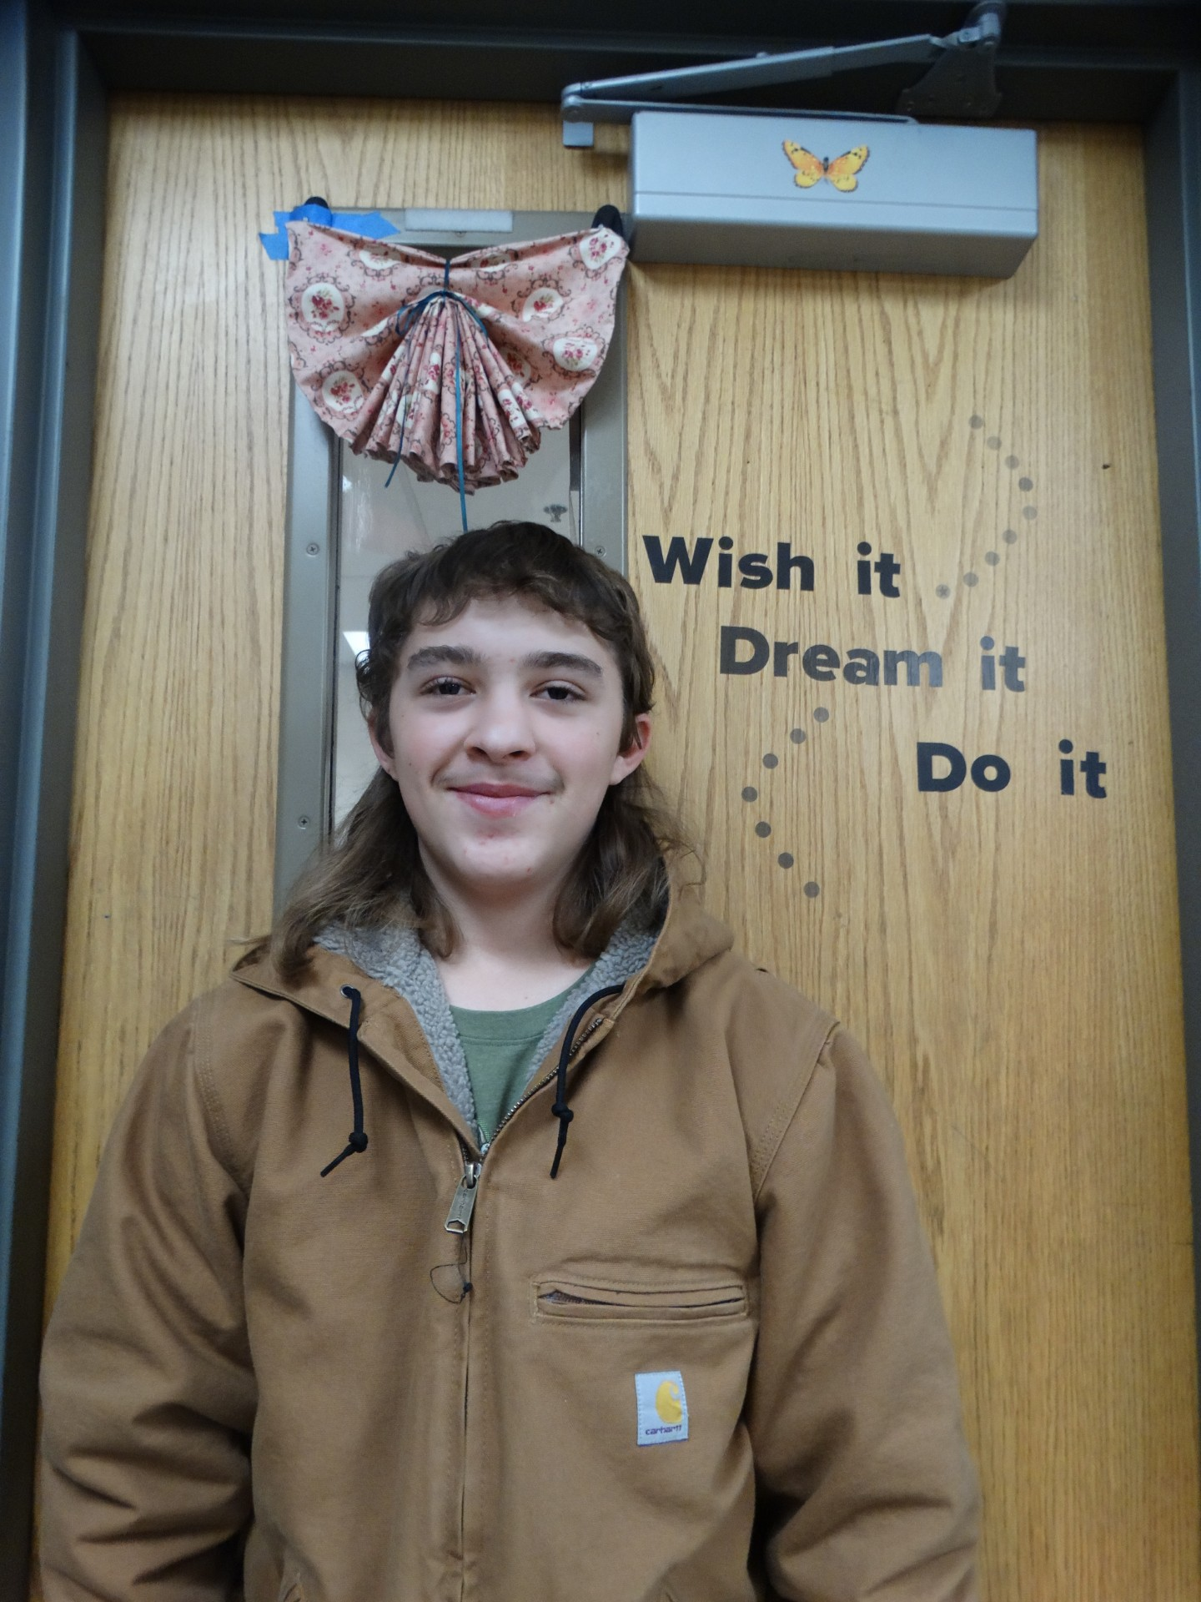
Alex Cheshire – 8th Grade Romney Middle School
Alex is a consistently pleasant and cooperative individual who contributes positively to any environment. He is always willing to help others and volunteer for group activities. He is reliable, takes responsibility and follows through on commitments with diligence. He has a dependable nature that makes him a valued member of the classroom!

Slide 16
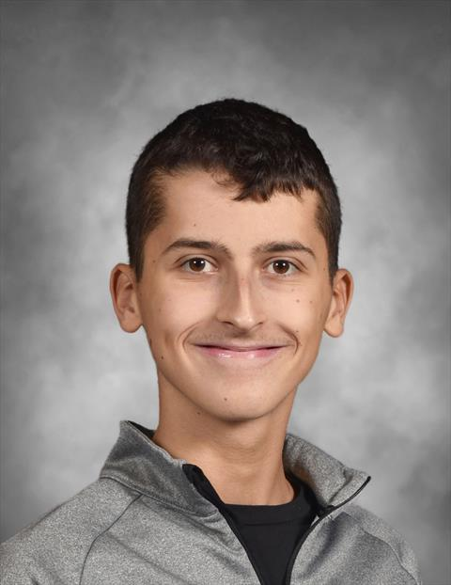
Chase Brill – 9th Grade Hampshire High School
Chase is a very sweet, polite and hard-working young man. As a freshman, his demonstrates exceptional manners, a strong work ethic and a willingness to volunteer whenever help is needed (without being asked!). Chase always goes above and beyond. His commitment to academics, volunteer efforts and basketball reflects his well-rounded character and determination. Chase carries himself with respect and sincerity at all times. His positive attitude makes him an absolute pleasure to know and work with. I love getting to have him in class!

Slide 17
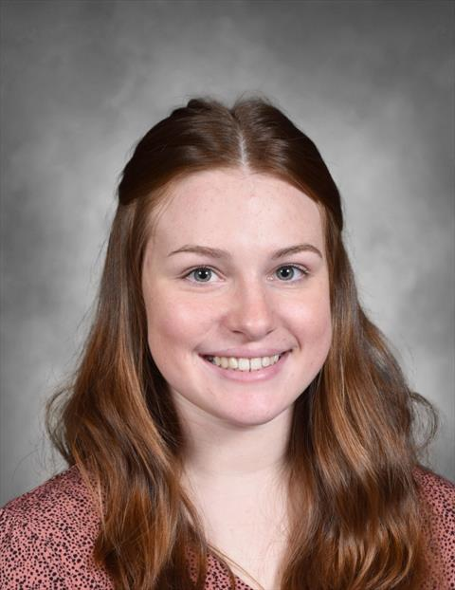
Lacy Eaton – 10th Grade Hampshire High School
Lacy is a great student with a pleasant attitude. She is only a sophomore but is taking Chemistry this year with Mr. Jordan because she is a high achiever. Chemistry is typically a junior or senior level class. Lacey always has a smile and strives to do well in school.

Slide 18
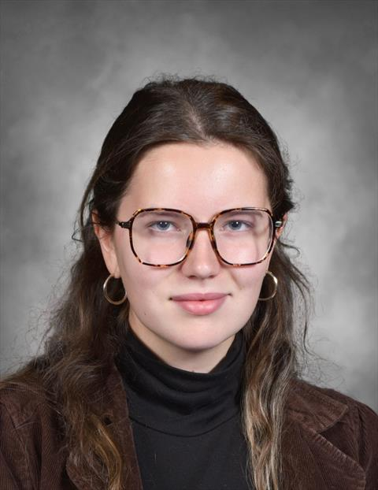
Ariel Smith – 11th Grade Hampshire High School
Ariel is just an all-around good student. She has a great attitude and is in band, Harmony, the upcoming performance of “The Little Mermaid” and swim. Even with all these extra activities, she still excels in her AP and honor classes.

Slide 19
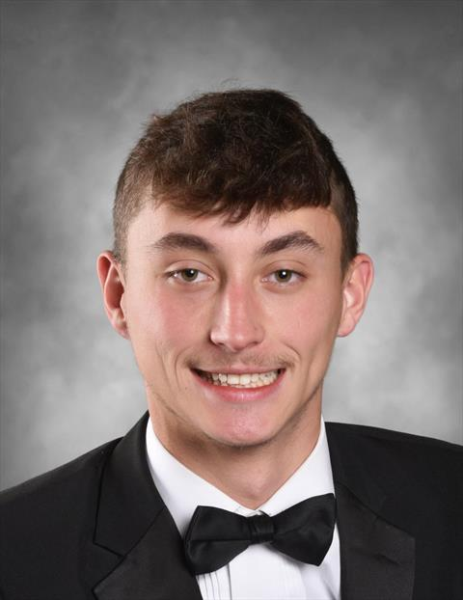
Jeremy Shank – 12th Grade Hampshire High School
Jeremy was recently caught helping plow snow around the school. With the heavy winds and drifts last month, the student parking lot was still a bit of a mess. Jeremy and his friend cam after school to help low the lot and get it clean. Jeremy can be counted on to help out with various hands-on jobs around the school.

Slide 20
Congratulations!!!

