Slide 1


CAKE
Catching a kid excelling!

Slide 2
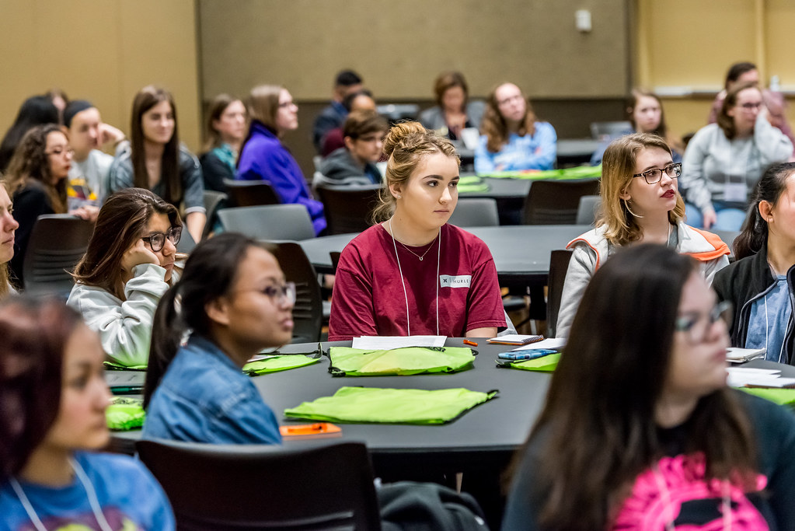
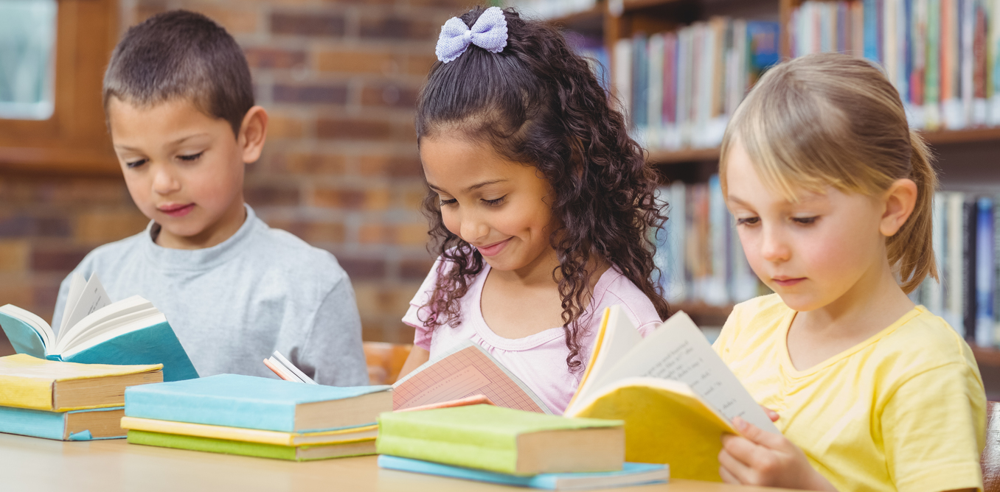
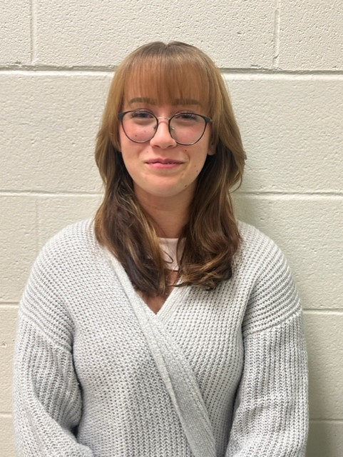
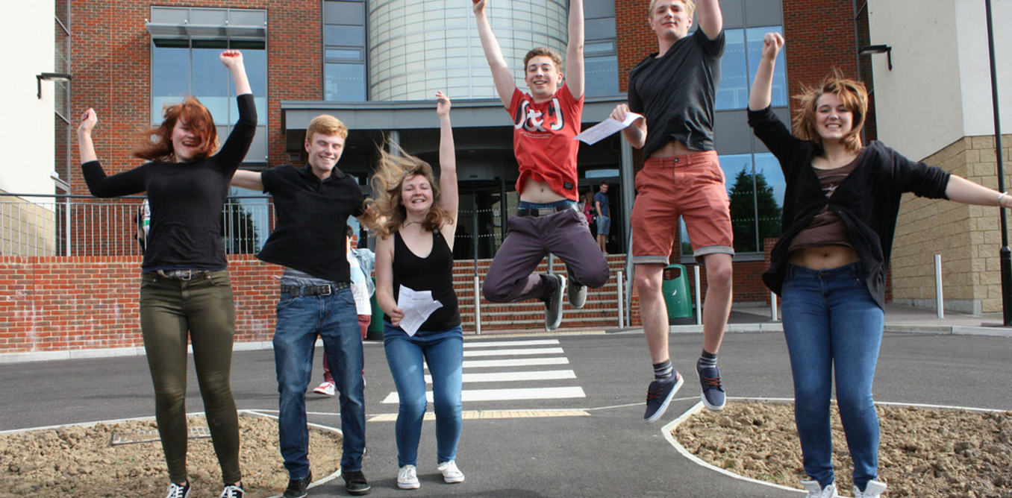
January 2025 CAKE students!

Slide 3
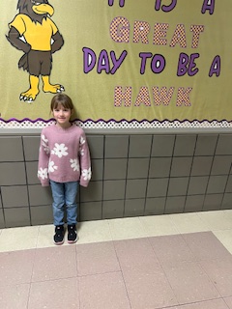
Alayna Reno – Capon Bridge Elementary
Alayna is a hard-working, kind and thoughtful student! She always does her best! Her teacher can count on her to be a great example to all classmates.

Slide 4
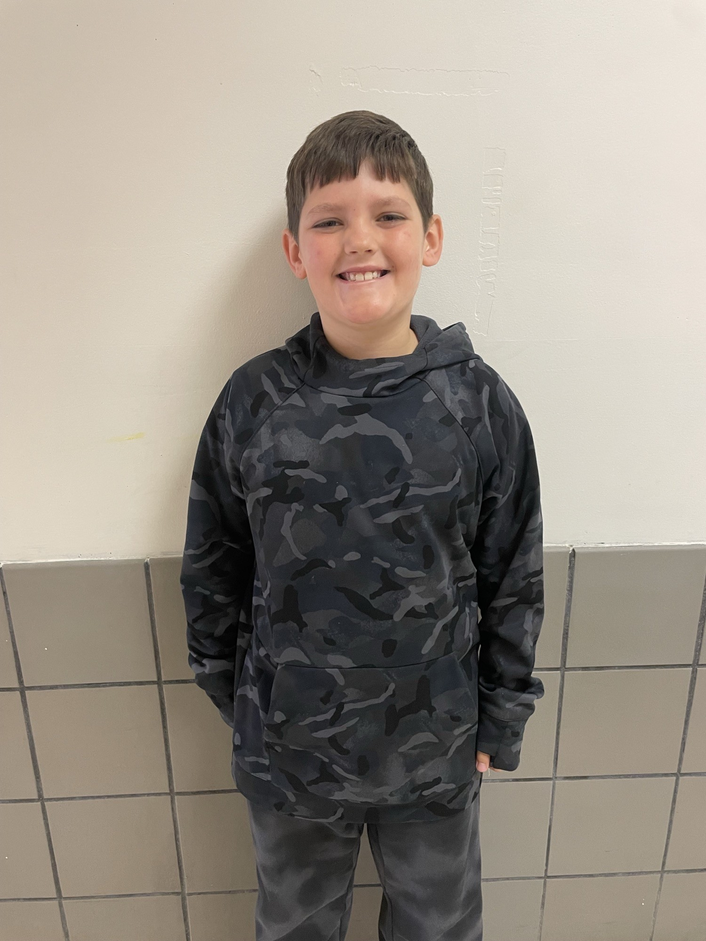
Giovanni Roberts – Capon Bridge Elementary
Giovanni is an amazing person and student. We can always count on Giovanni to be on task and follow directions. He is pleasant, kind, and respectful. He is a wonderful peer helper for his classmates and supports them with their classwork and with fun activities. We appreciate his good attitude and the smile he always has on his face. He is also a hard worker and has a great work ethic. He gives 110 percent to all work that he completes. He is making steady growth in Reading and Math. It is a pleasure to work with him this school year. Congratulations Giovanni on being the 3rd grade CAKE student for the month ofJanuary. We are proud of you !!!!!!

Slide 5
Nika Byrd - Windy Ridge
Nika was chosen because the Windy Ridge cafeteria staff say she is the first student they have ever met that checks in with them everyday to inquire if they are having a good day. Her teachers report that she is the sweetest and kindest student to all her friends and fellow classmates. She goes above and beyond in all she does. Her personality lights up the room and makes everyone around her feel good. Her smile is infectious to all who know her. She is joyful.

Slide 6
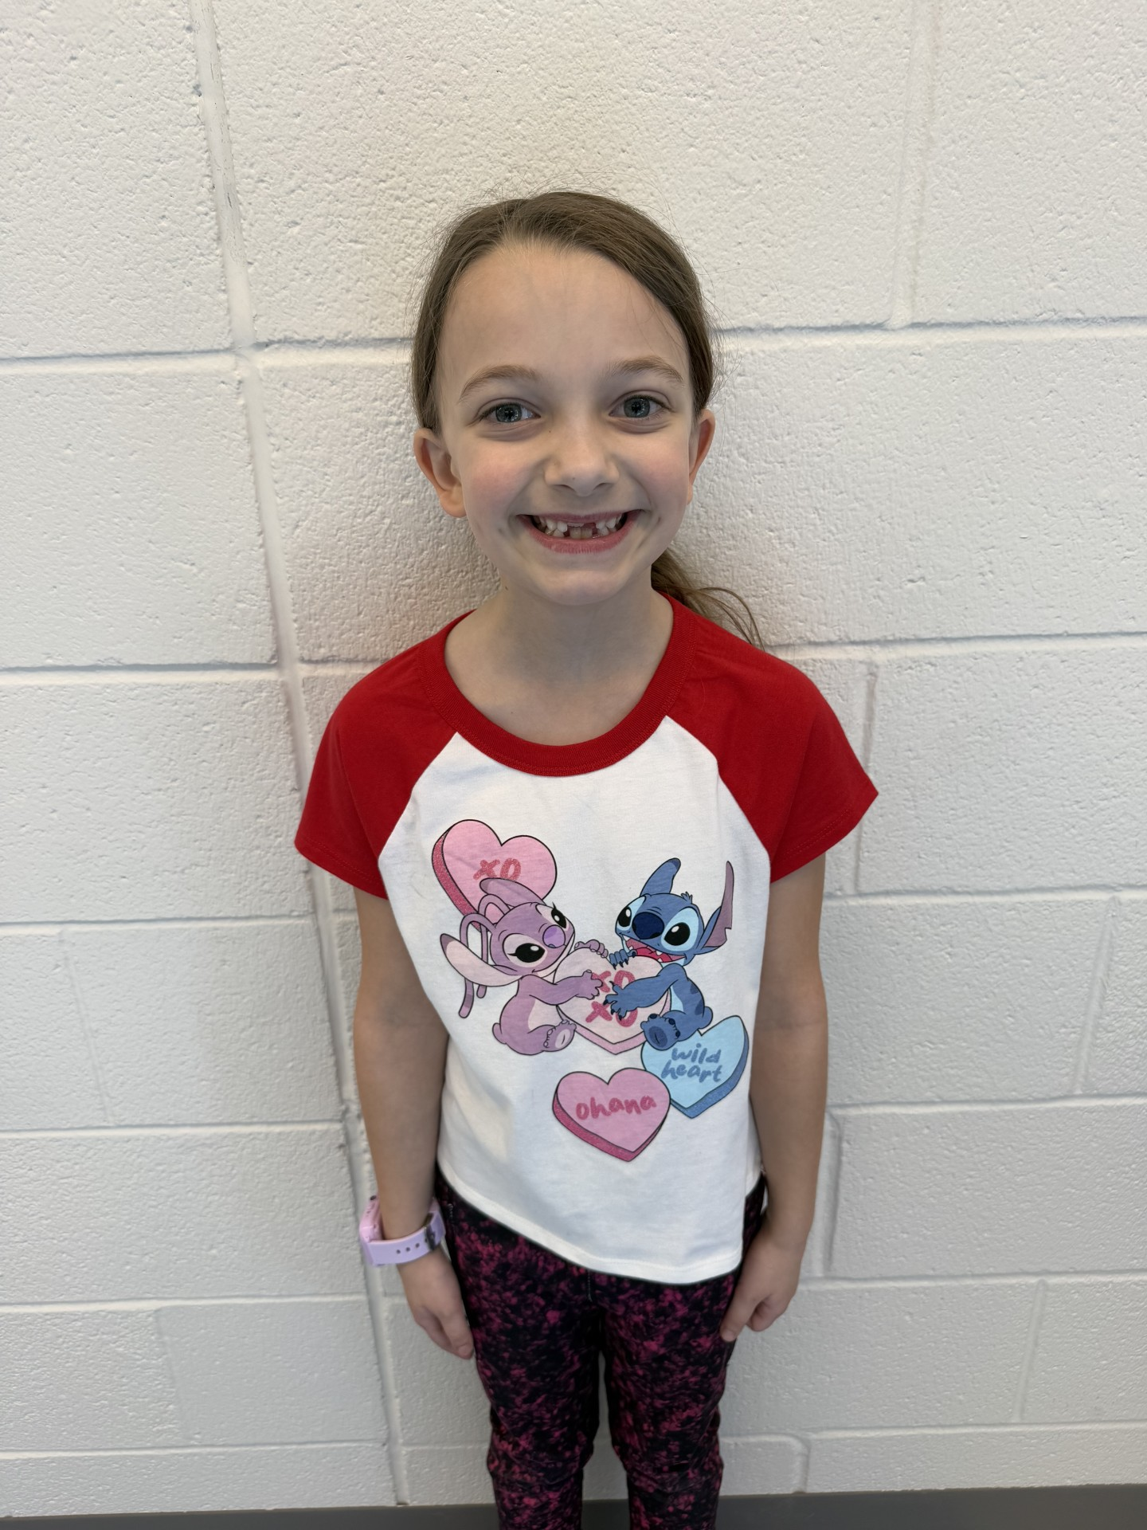
Scarlet Young – Ice Mountain Elementary School
Scarlet is such a kind, sweet, compassionate young girl. She strives every day to do her best, and to show kindness to her friends. She perfectly embodies what it means to be honest, hardworking and of good nature. Her attitude and smile are always welcomed and heart-warming in our classroom. She is a light to all of her classmates and her teachers.

Slide 7
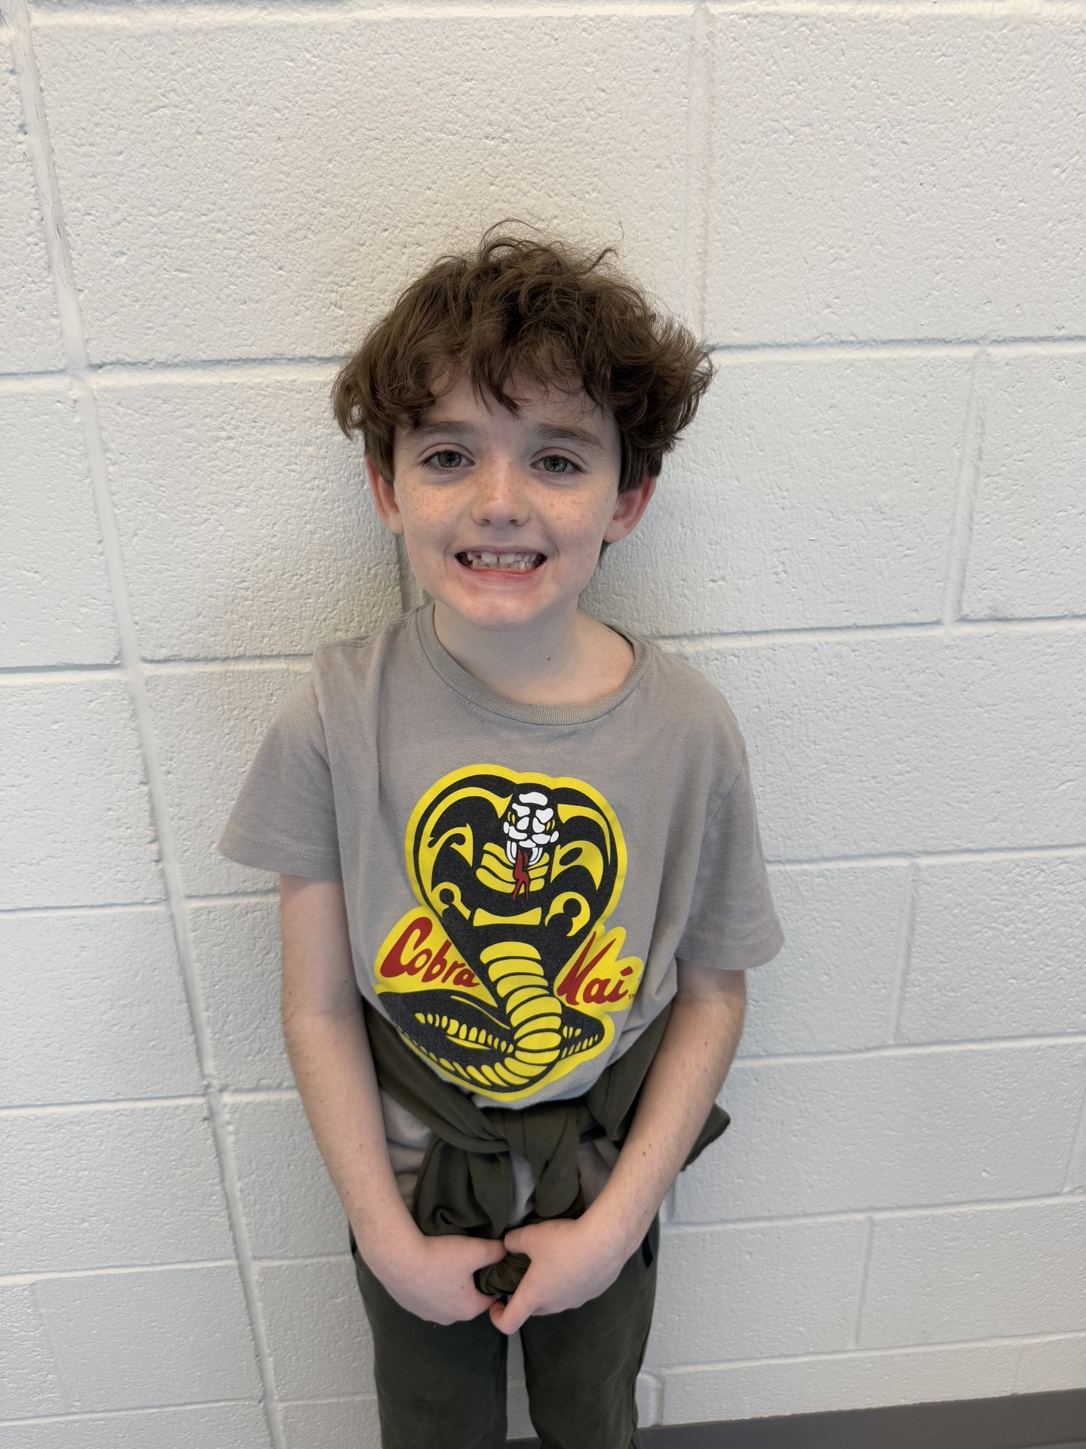
Paxton Frye – Ice Mountain Elementary School
Paxton is a sweet, happy, smart young boy. His personality is one of the best. With his silly facial expressions, he never fails to make his class and teachers laugh. He participates in everything during instruction time. Even if he is uncertain, he puts his best foot forward. Paxton is a true joy to everyone he is around.

Slide 8
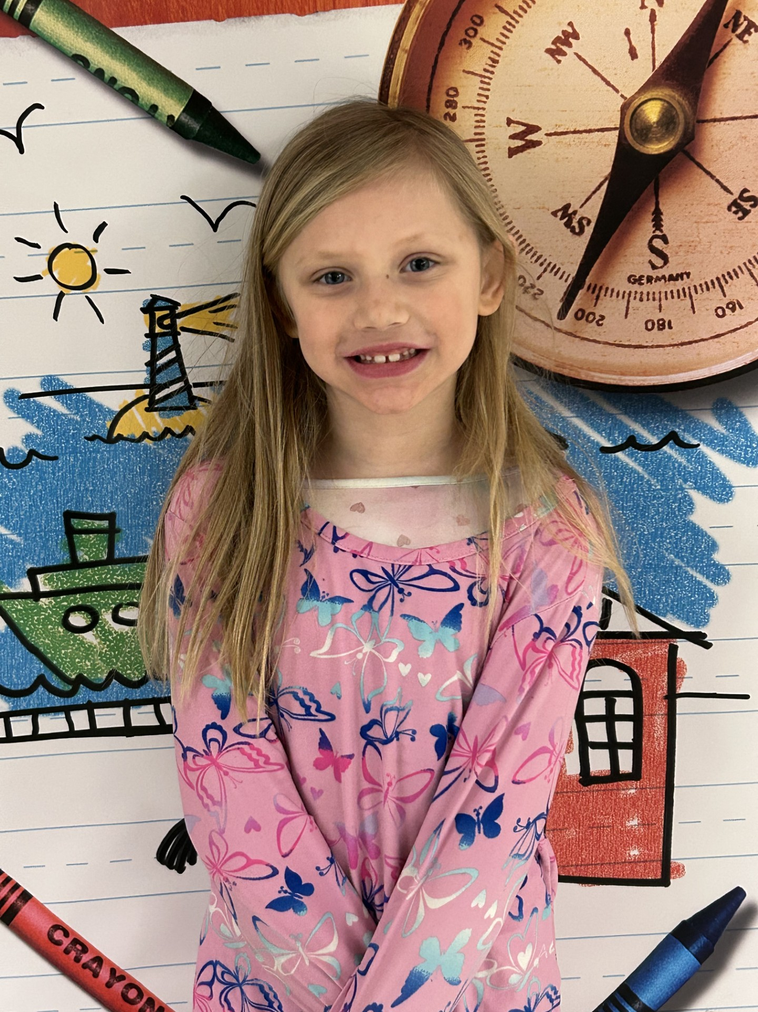
Trinity Corbett – South Branch Elementary
Trinity is a hard worker. She is always volunteering to answer any questions or help out a classmate. She is always being proactive and never gives up. Trinity does well in Math and Reading. She has been improving and continues to do her best. She is a wonderful student and will continue to do great things!

Slide 9
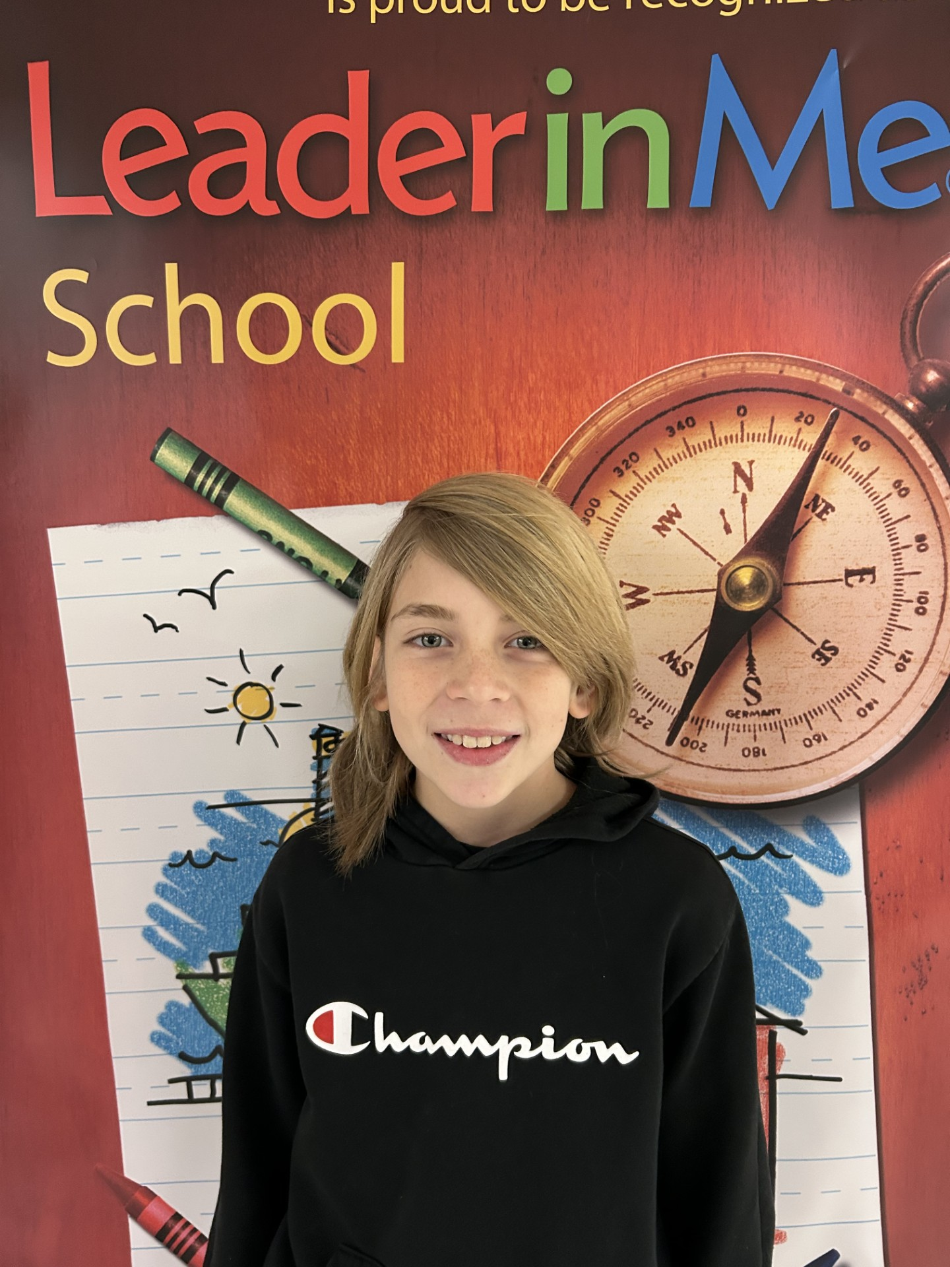
Jay Ruckman – South Branch Elementary
Jay is a student who always strives to do his best. He begins with the end in mind and works towards successfully completing any task he is presented with. Jay is creative in all aspects and is eager to share his out of the box thinking with his classmates. Jay has adjusted well to being in a new school this year and has made a lot of friends. I know Jay is going to do amazing things in his life!

Slide 10
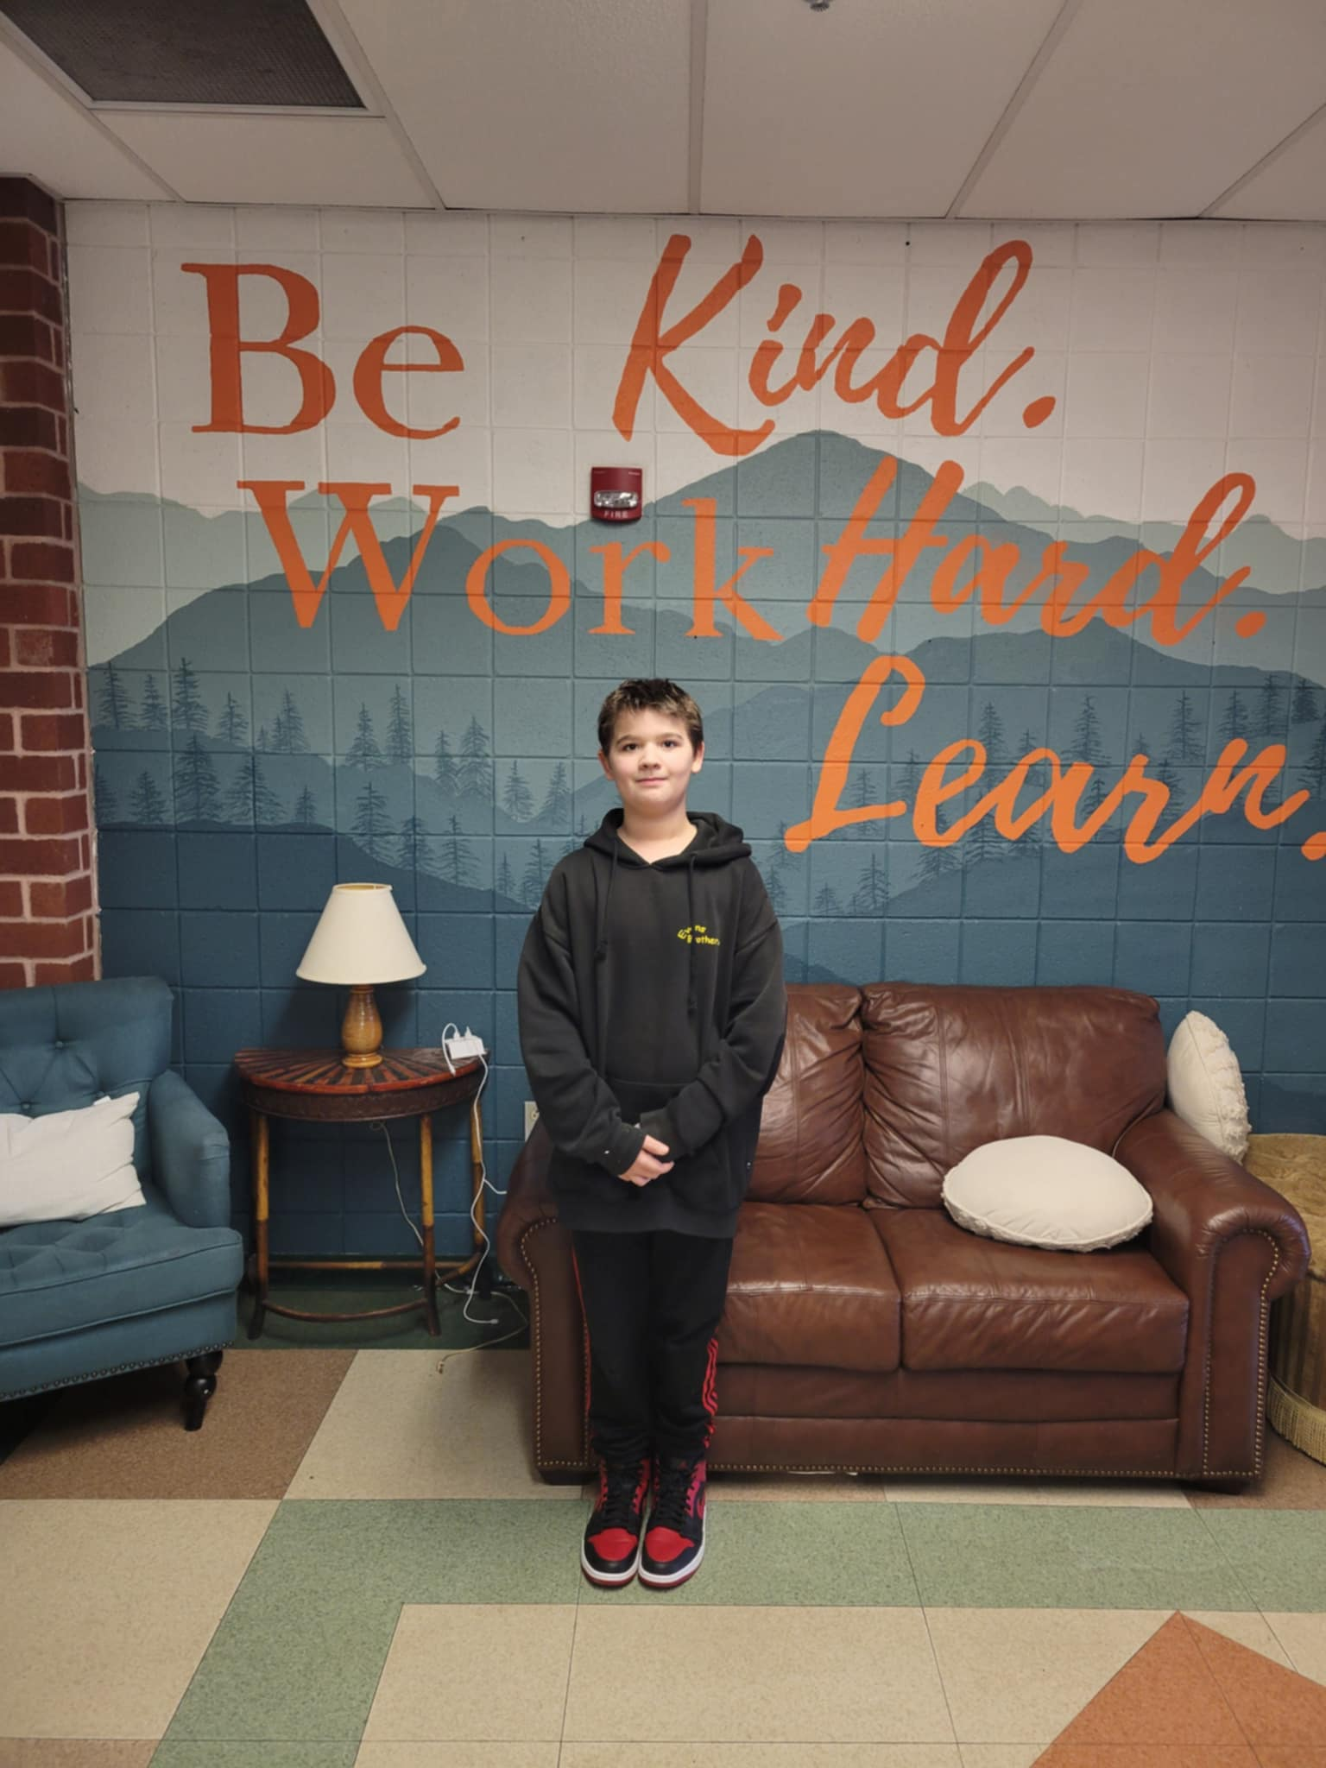
Era Moore – 6th Grade Capon Bridge Middle School
Ezra was chosen because he exemplifies the qualities valued the most: kindness, a positive work ethic and a willingness to learn. He has shown exceptional character by treating others with respect and compassion and creating a welcoming environment for classmates and teachers alike. His dedication to his work and consistent effort to go above and beyond expectations reflect his strong work ethic. His eagerness to learn and embrace new challenges demonstrate a growth mindset that inspires everyone around him. He is a shining example of what it means to live by the CAKE values.

Slide 11
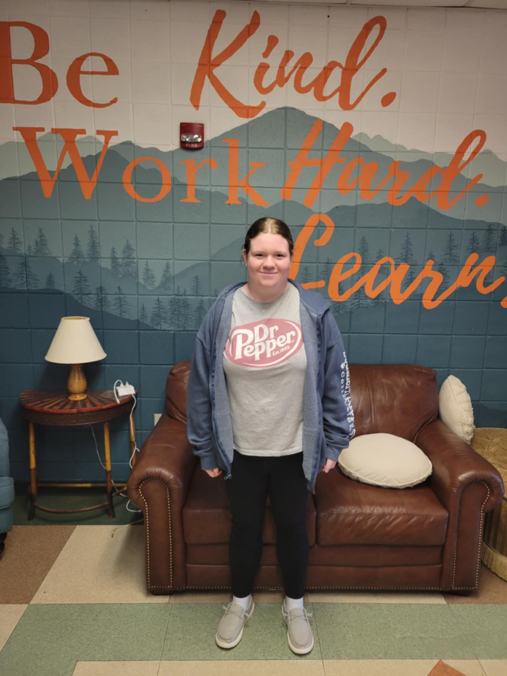
Haven Hawkins – 7th Grade Capon Bridge Middle School
Haven was chosen because he is always willing to learn. He displays a positive attitude and is always cheerful. He is helpful to his classmates, puts forth his best effort on all assignments and goes above and beyond!

Slide 12
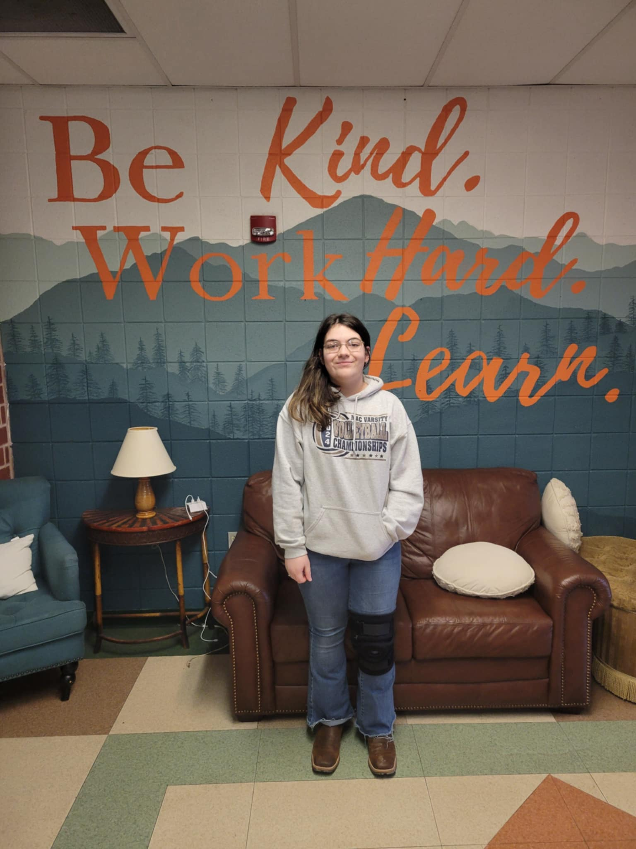
Grace Miller – 8th Capon Bridge Middle School
Grace Miller – Grace was chosen because she has a positive and pleasant presence in school. She has consistently approached each day, class and interaction with a smile and a kind word. She faces classwork and challenges calmly and confidently, while also ensuring to encourage others in the process. She makes sure to put her best foot forward each day. She has been a PAWsome Bobcat to students and staff!

Slide 13
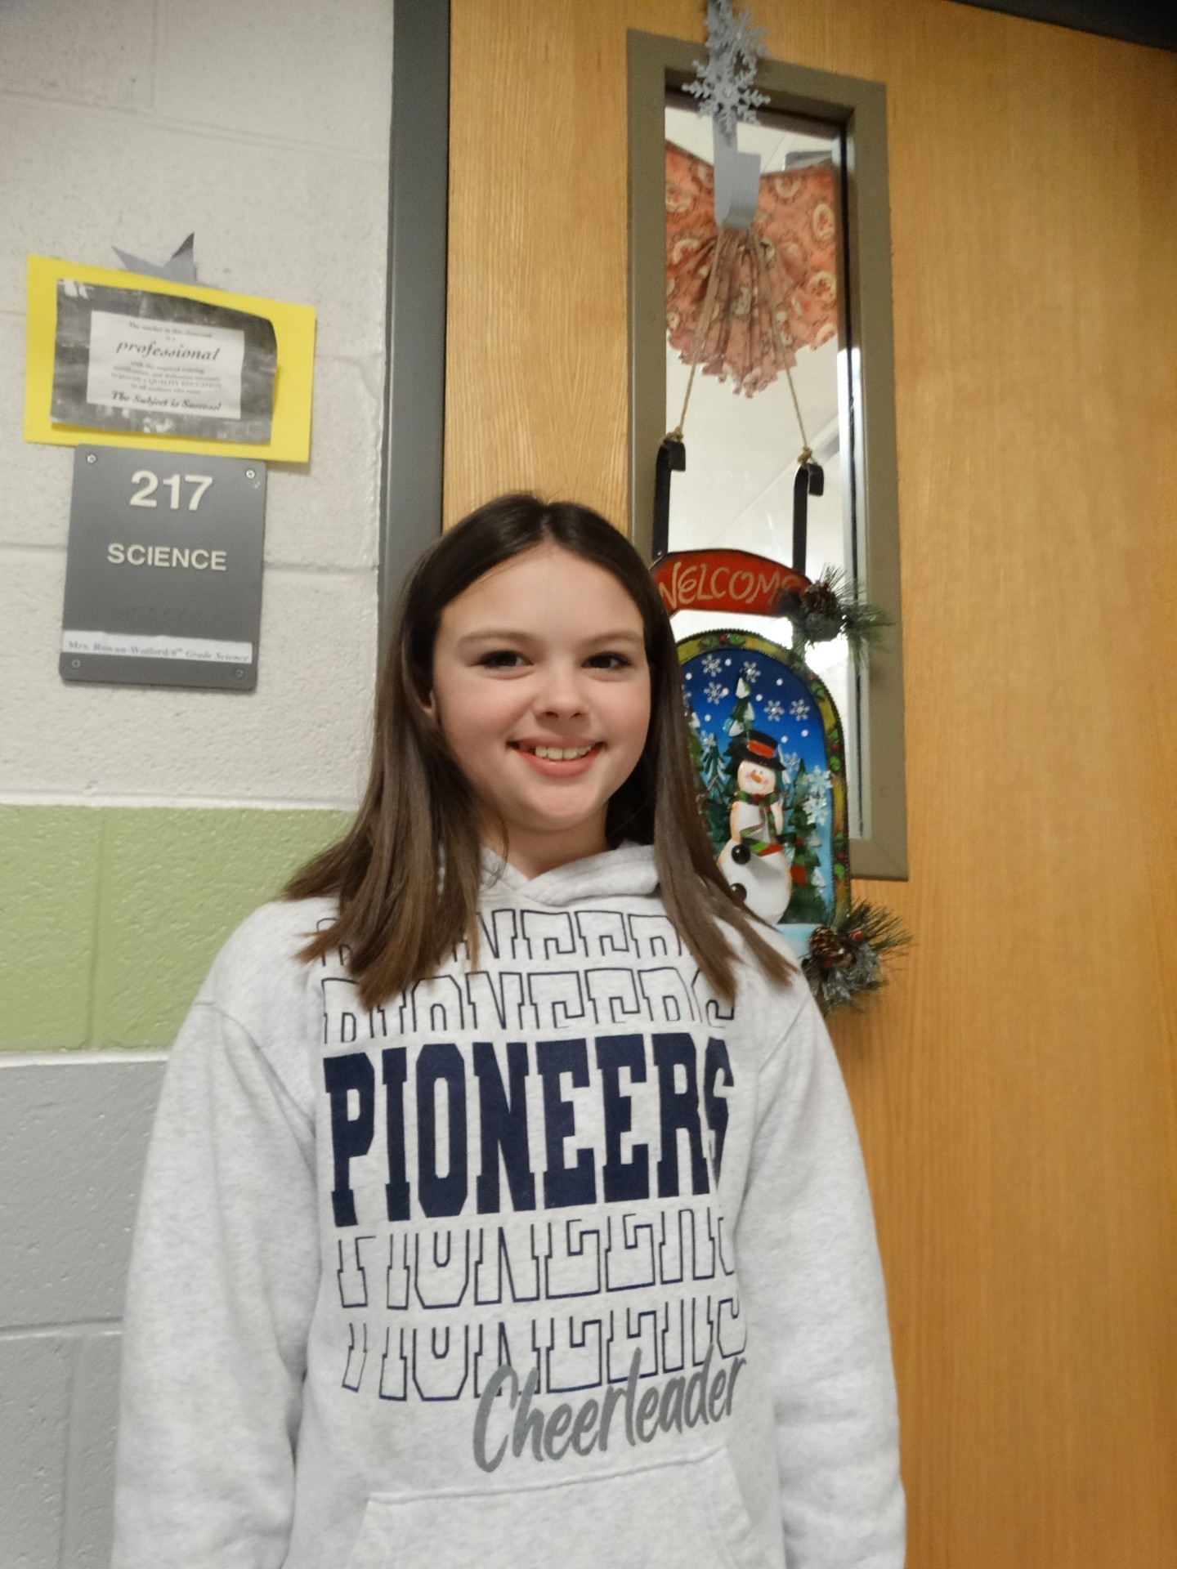
Brileigh Clark – 6th Grade Romney Middle School
Brileigh is a sweet person who wears a friendly smile wherever she goes! She is studious and conscientious about her grades and eager to beat her personal best in any academic endeavor she undertakes. She also works hard at her extra-curricular activities like cheerleading and practicing her softball moves even during the off-season. She is also a member of the 6th Grade Math Field Day team. She is an outstanding student who is a great role model!

Slide 14
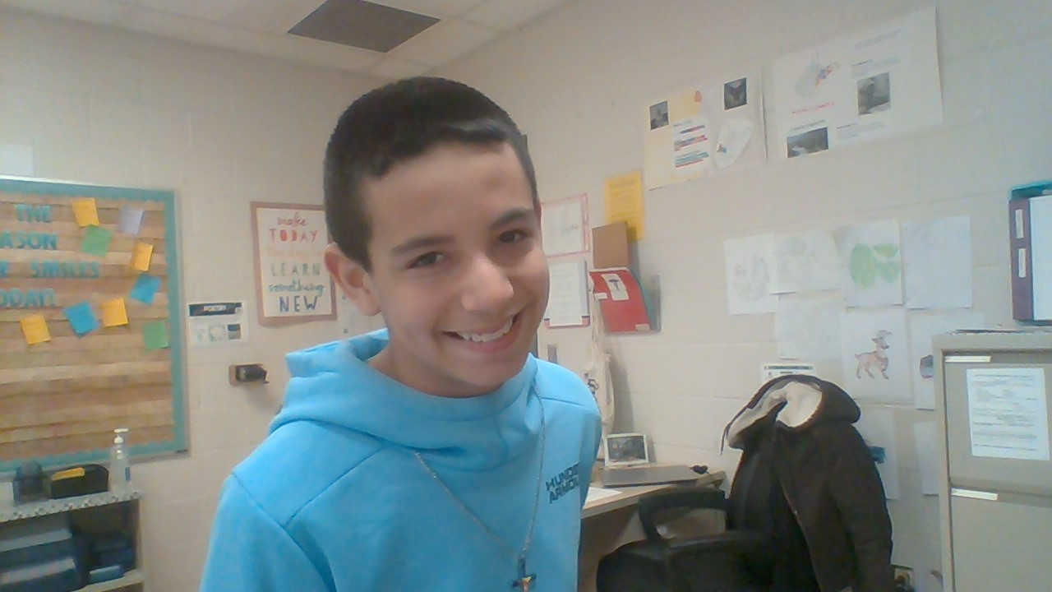
Ayden Johnson – 7th Grade Romney Middle School
Ayden shows responsibility in his daily school routine. He comes to class prepared and ready to work. He actively participates in class and is a good model for others. He uses good manners and is courteous to others. He is helpful in many ways. He lends a helping hand to teachers by passing out papers and making sure the classroom door is always locked. He helps fellow classmates pack up their belongings and clean up messes. He is kind and generous. He makes others feel welcome and includes his peers during activities. He lights up a room with his smile! No matter what the situation or challenge the teacher may have faced during the day, when they see his face, it makes their day better.

Slide 15
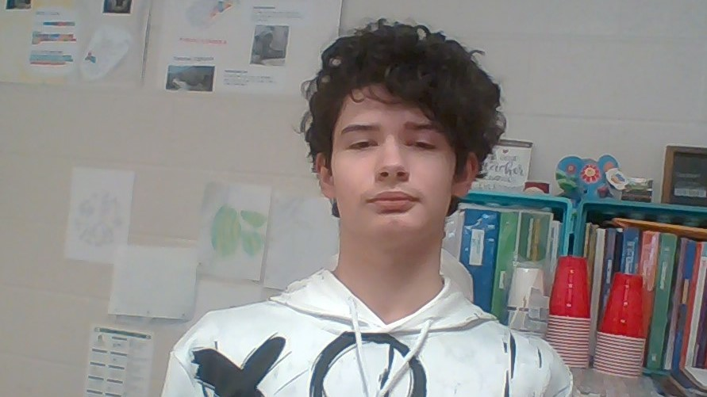
Bryley Sisler – 8th Grade Romney Middle School
Bryley is an exemplary student who consistently demonstrates a strong work ethic and dedication to her studies! He approaches every task with determination, never shying away from putting in the effort required to be successful. He is always polite, respectful and well-mannered. He offers help to classmates in need. He shows a genuine kindness and a willingness to support others. His combination of hard work, kindness and thoughtfulness make him a truly great candidate and winner of the CAKE award.

Slide 16
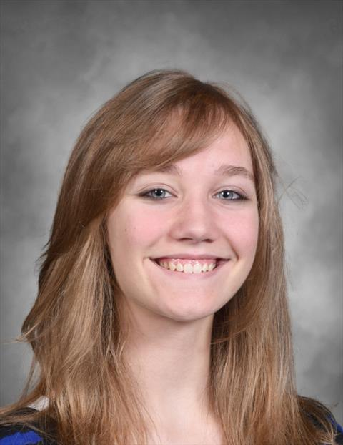
Dorothy Blau – 9th Grade Hampshire High School
Dorothy is a quiet student who always gets her work done. She does whatever is asked of her and goes out of her way to help her peers. She is always very polite and friendly. She is also part of the Academic Showdown Team that will compete in January!

Slide 17
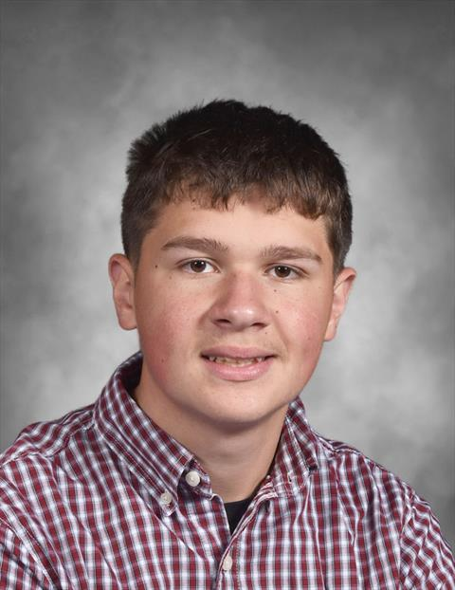
Jackson Dice – 10th Grade Hampshire High School
Jackson is an all-around good student. He is a member of the cross-country team and earns good grades. He was an important member of his Honors English class last semester and pulled his peers together so they had a cohesive classroom environment. He has a great sense of humor and works well with others.

Slide 18
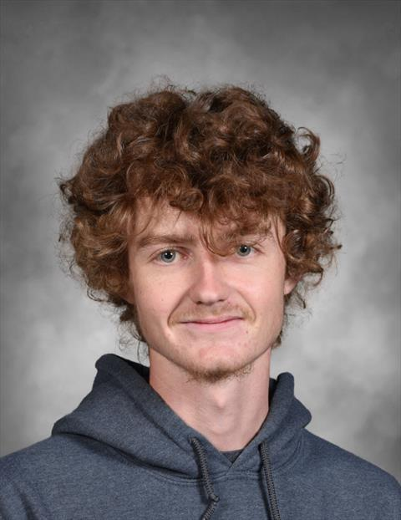
Dakota Hess – 11th Grade Hampshire High School
Dakota is a new member of Link Crew and from the beginning was ready to jump in feet first and help out in any and all ways. In class he can be seen collaborating with peers and taking on challenges given to him. He is always finding humor and positive aspects throughout his day and never misses a chance to say hello or to be kind to teachers and friends in the hallway. Dakota works very hard outside of school while farming for his family. He's a great kid!

Slide 19
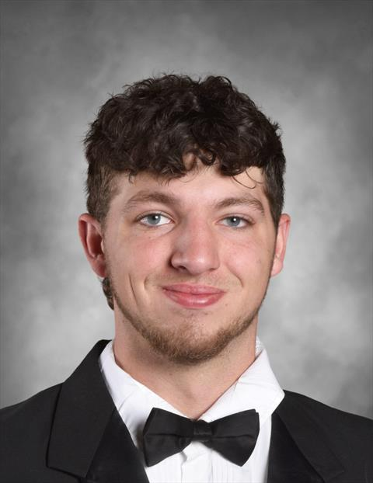
Hayden Pyles – 12th Grade Hampshire High School
Hayden was recently caught helping plow snow around the school. With the heavy winds and drifts, the student parking lot was still a bit of a mess. Hayden volunteered to help plow and stopped by after school to get the job done. Hayden is great with machinery and tools. He has been involved in FFA and ag during his four years at HHS.

Slide 20
Congratulations!!!

