Slide 1


CAKE
Catching a kid excelling!

Slide 2
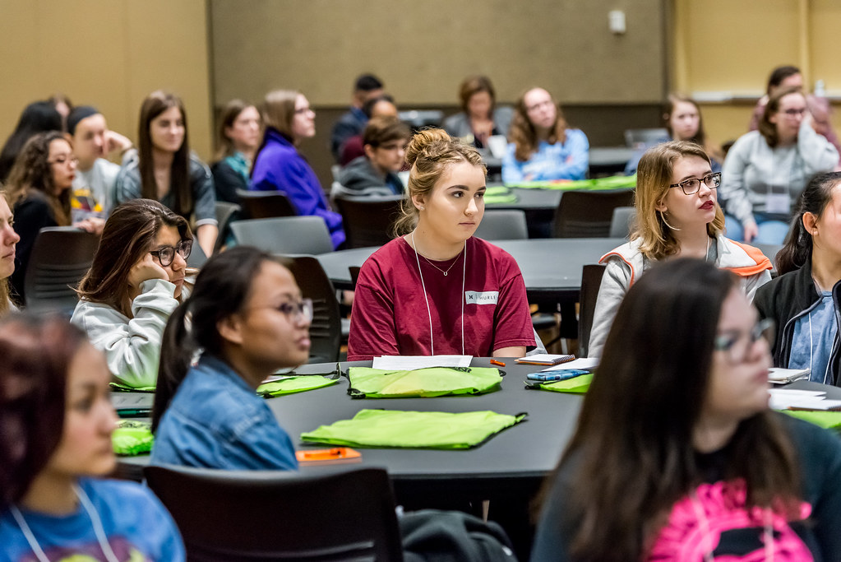
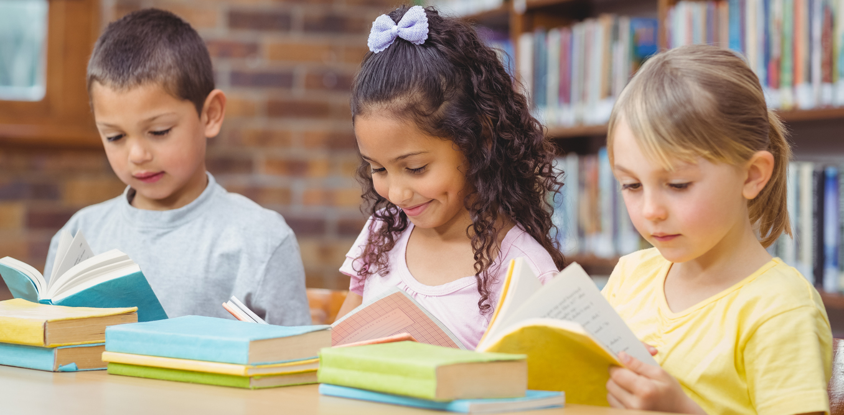
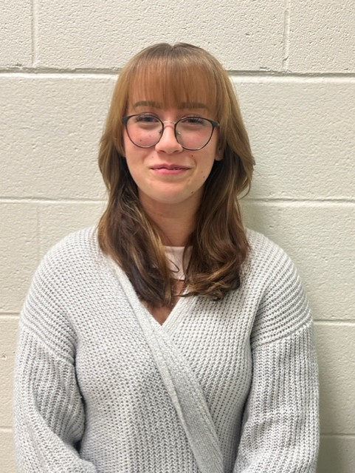
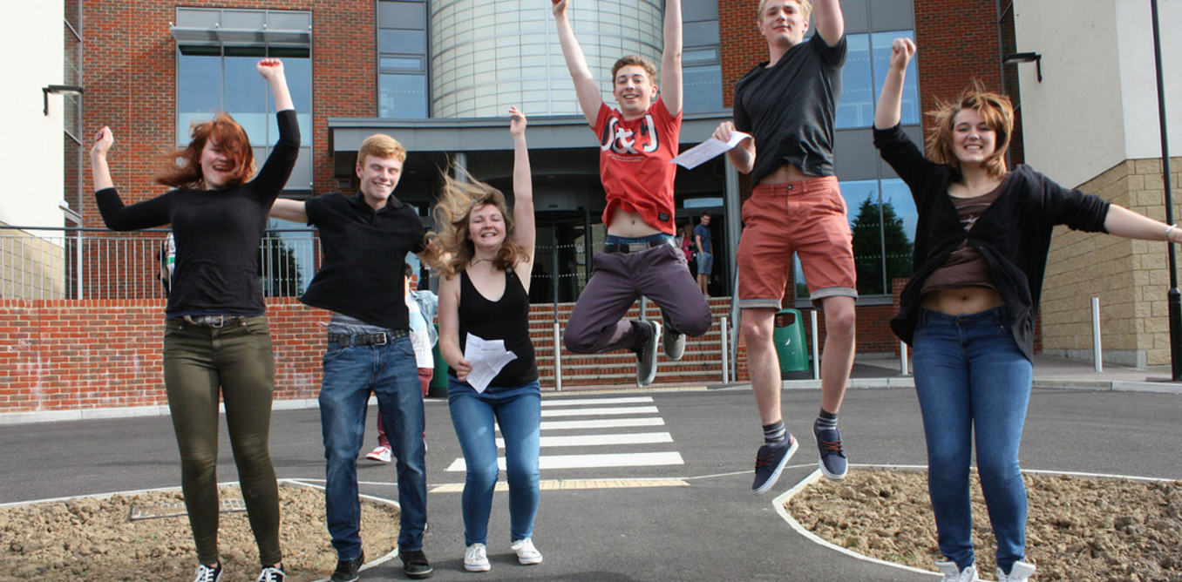
December 2024 CAKE students!

Slide 3
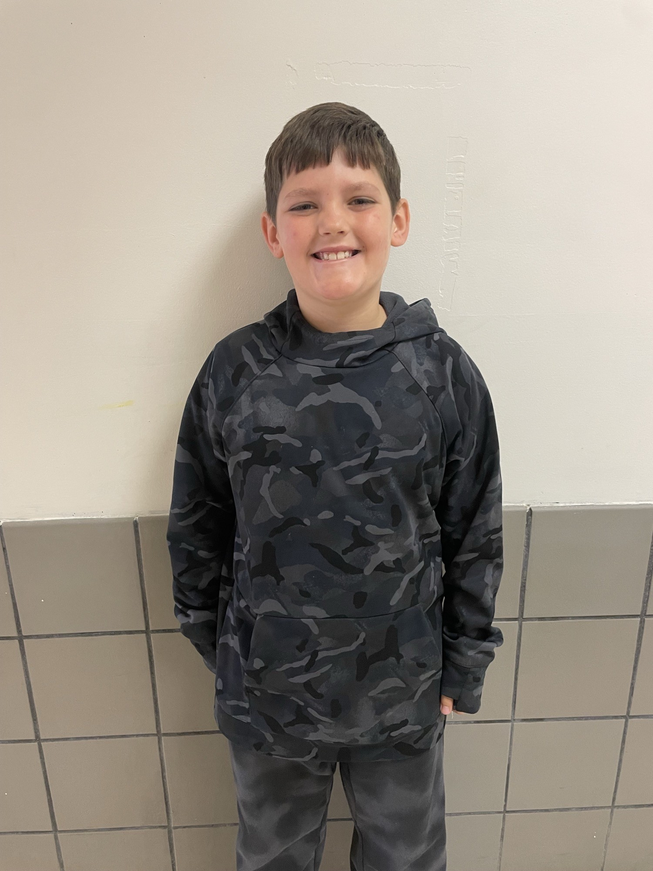
Giovanni Roberts – Capon Bridge Elementary
Giovanni is an amazing person and student. We can always count on Giovanni to be on task and follow directions. He is pleasant, kind, and respectful. He is a wonderful peer helper for his classmates and supports them with their classwork and with fun activities. We appreciate his good attitude and the smile he always has on his face. He is also a hard worker and has a great work ethic. He gives 110 percent to all work that he completes. He is making steady growth in Reading and Math. It is a pleasure to work with him this school year. Congratulations Giovanni on being the 3rd grade CAKE student for the month ofJanuary. We are proud of you !!!!!!

Slide 4
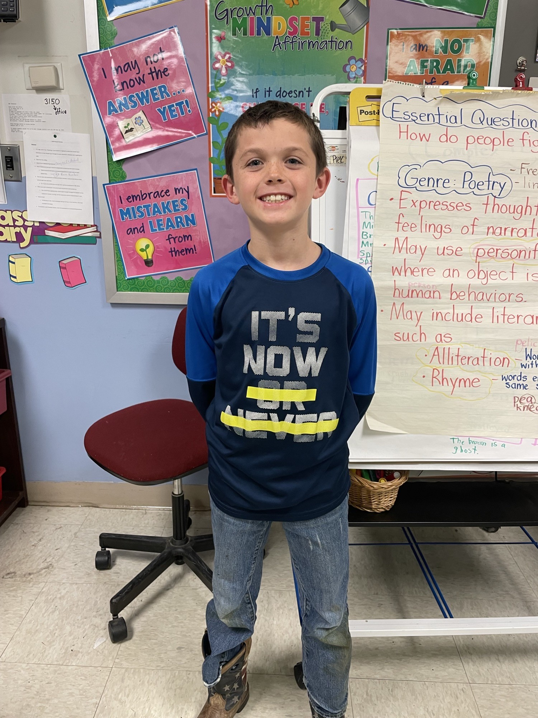
Owen Charlton – Capon Bridge Elementary
Owen was chosen because you have a heart of gold! You are kind and considerate to teachers and other students. You will always be utilized as a peer helper because you are an excellent role model for the way a third-grade student should behave and work at school. You are cooperative and alert. You always have a smile on your face and are positive about schoolwork and the relationships you have with other students. You complete your work quickly and accurately. We are so proud of the way you mastered multiplication facts to 12. You were on the 4.0 honor roll for the first weeks. We enjoy hearing about your love for the sports of football and we look forward to hearing about your achievements in this sport.

Slide 5
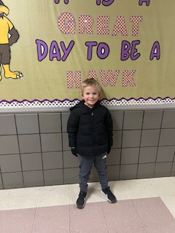
Ryker Loy – Capon Bridge Elementary
Ryker has improved throughout the year and is very kind to other students and staff. He is always willing to help and has a positive attitude when doing classwork. He follows the rules and works hard on assignments. He has a very good sense of humor.

Slide 6
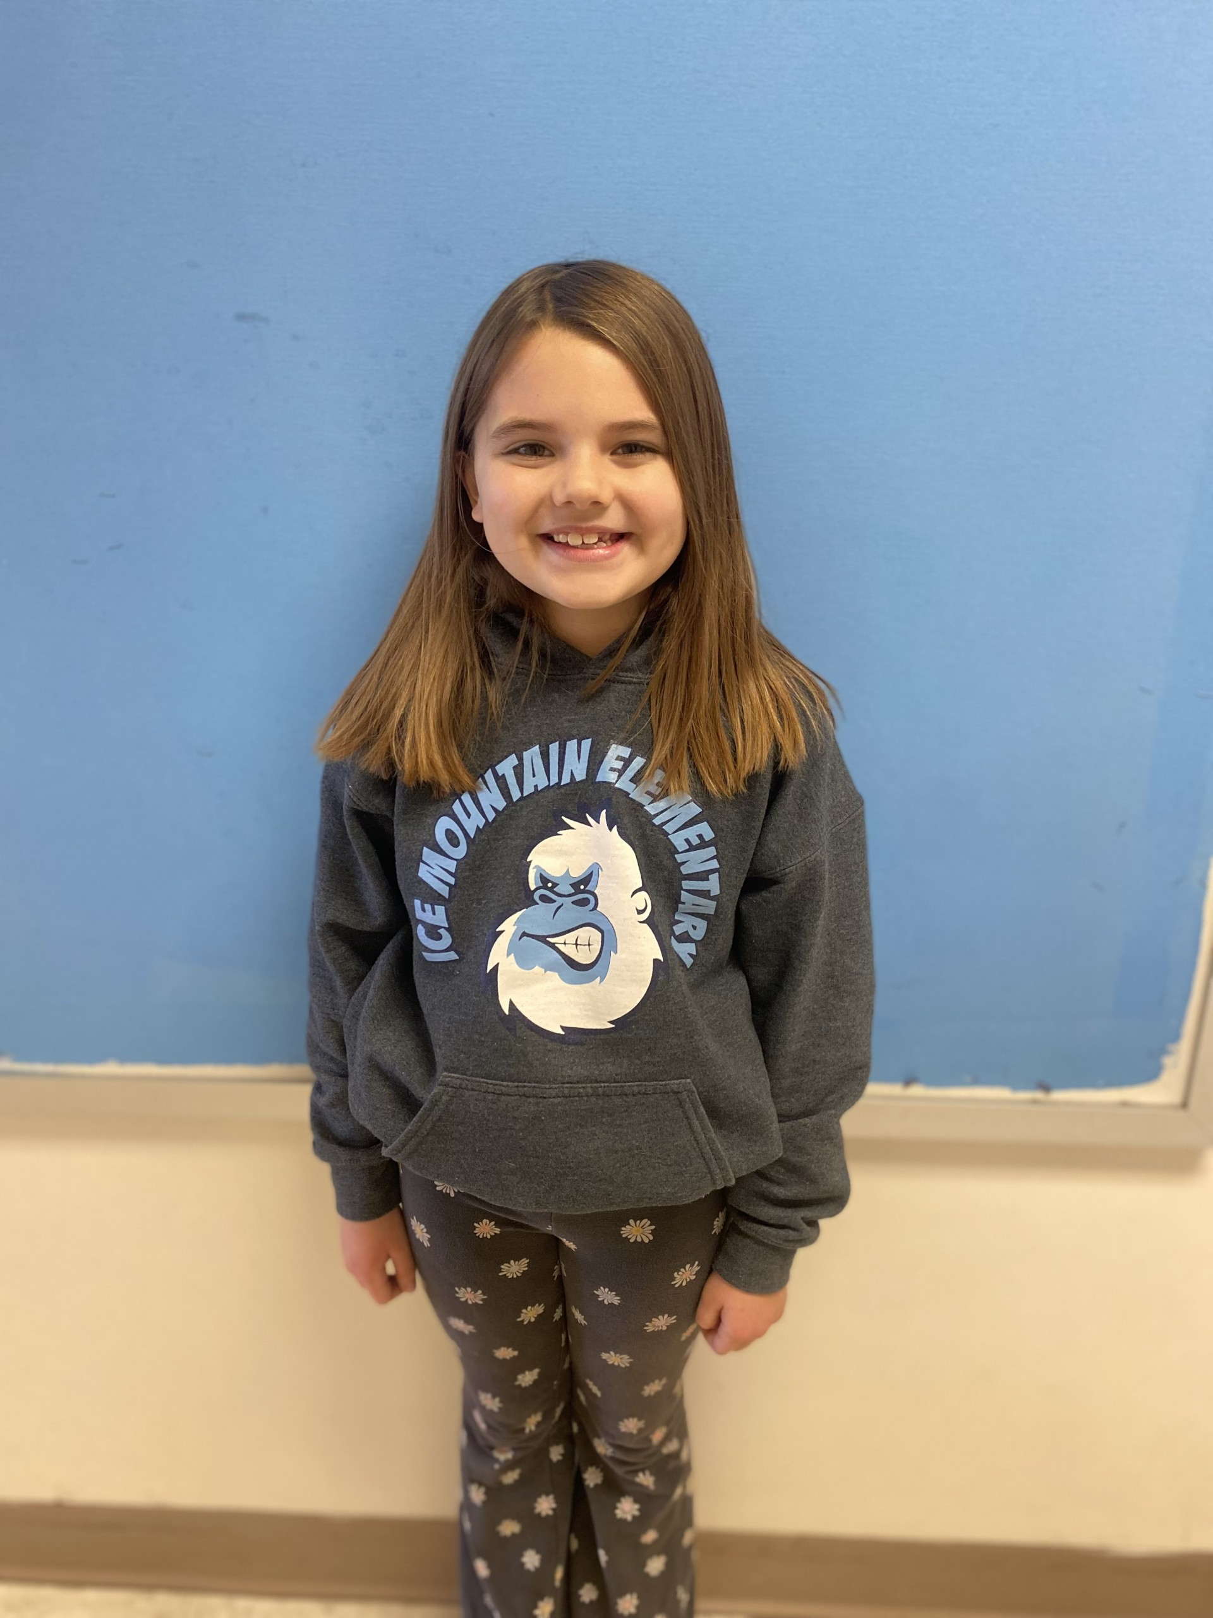
Lottie Broderick – Ice Mountain Elementary School
Lottie is a fun third grader with a lot of personality! She is a great, overall student. She strives to do her best and is always asking questions. Lottie did very well mastering her multiplication facts. When needed, she is always there to help her classmates. Lottie loves anything related to arts and crafts!

Slide 7
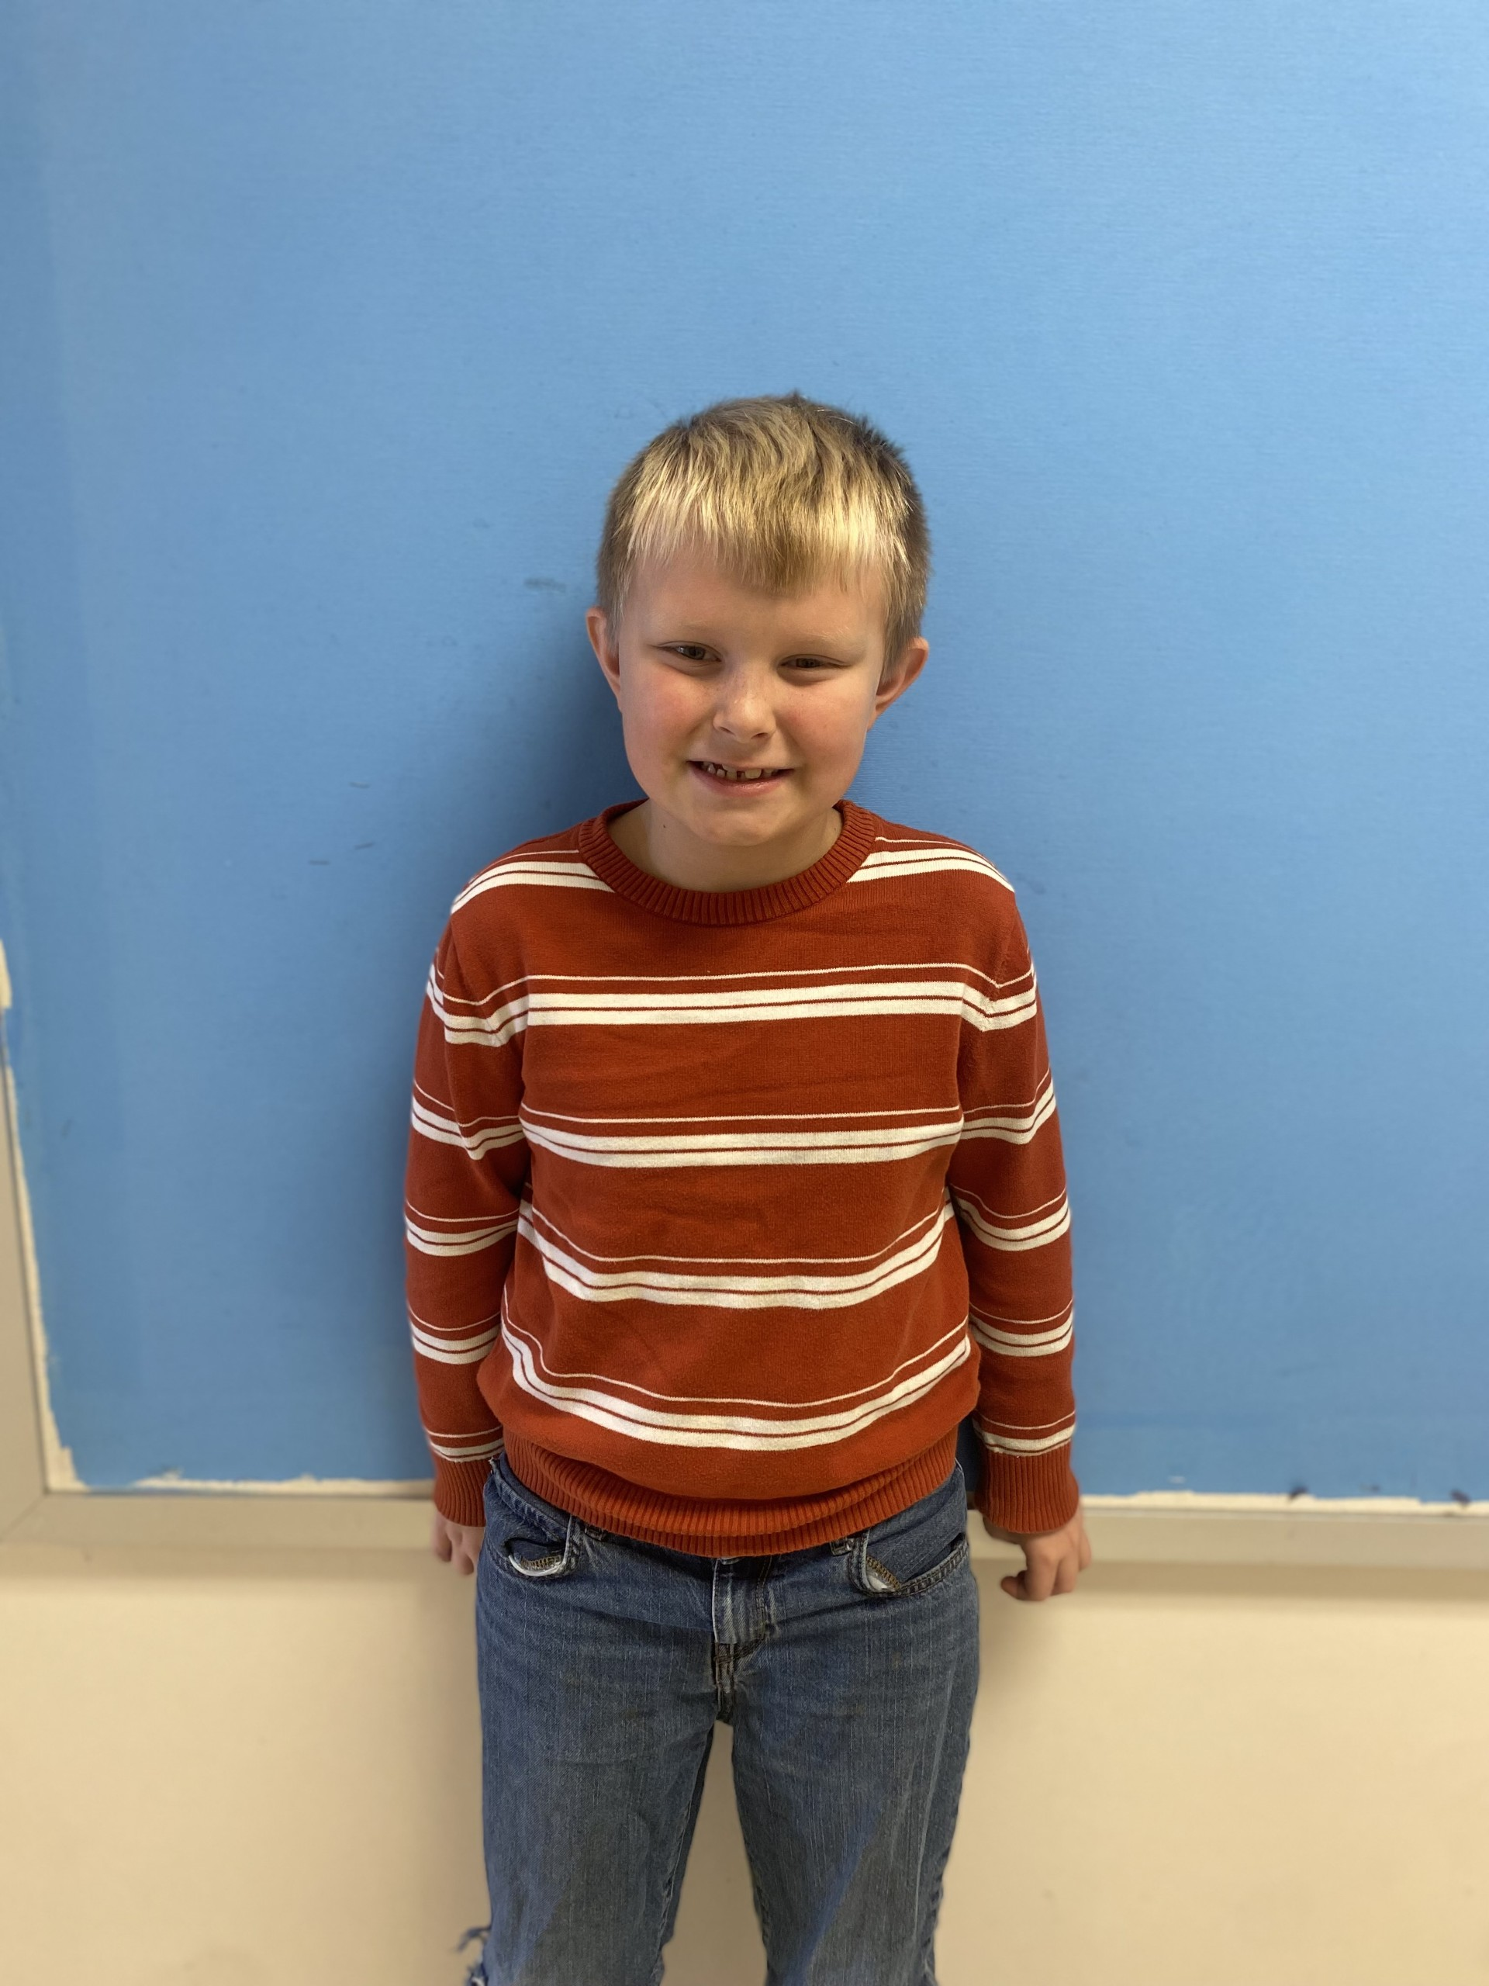
Landon Keplinger – Ice Mountain Elementary School
Landon is a great second grade student who really loves school. Landon does everything he can to strive to do his absolute best at his work. He is doing very well understanding our newest chapter in math on Money. Landon is an active boy and loves a game of soccer!

Slide 8
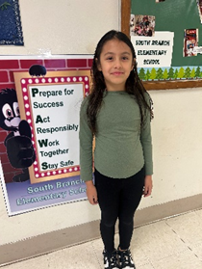
Lydia Shoemaker – South Branch Elementary
Lydia is a second-grade student in Mrs. Walker's class. She has excellent attendance and a positive attitude in the classroom. She is a great role model for her classmates and shows maturity when working with them. Lydia excels in all academic areas and is enthusiastic about learning new material. She sets high standards for herself and reaches them. Finally, Lydia is a good friend to all and makes our classroom a brighter place.

Slide 9
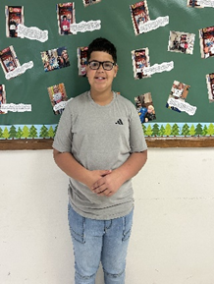
Ashton Denmark – South Branch Elementary
Ashton has been caught excelling at iReady Math lessons. He set a personal goal and has worked hard to accomplish it. When the lessons were challenging, he persevered until he mastered them! He has applied this winning attitude in other areas as well, helping him to be a great student.

Slide 10
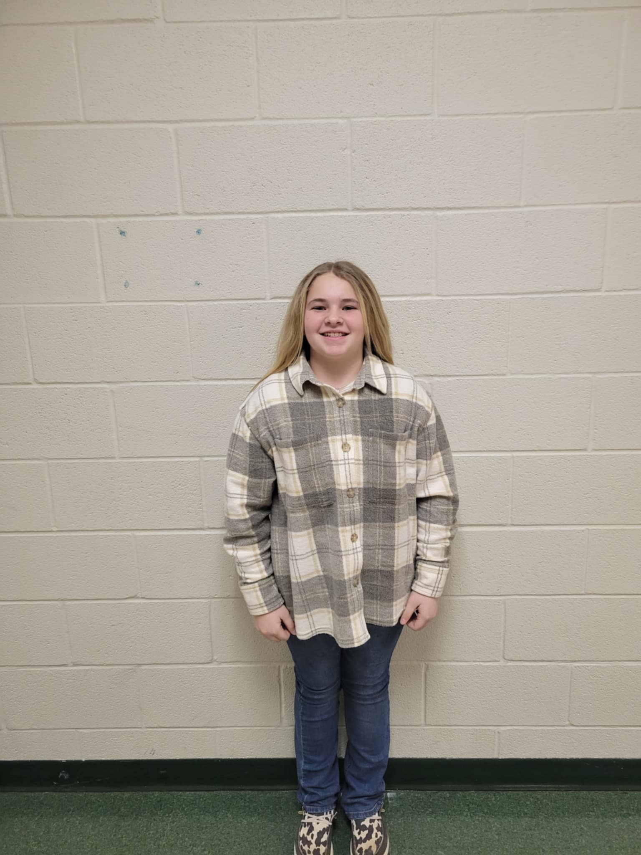
Kinley Fry – 6th Grade Capon Bridge Middle School
Kinley has been chosen for this award because of her unwavering kindness, consistent dedication to hard work, and her incredible willingness to learn. Kinley’s positive attitude and commitment to growth are a shining example for her peers and our entire school community. She embodies the values we hold dear here at CBMS and she makes our school a better place every day. Congratulations, Kinley! Keep up the amazing work—you are truly deserving of this honor!

Slide 11
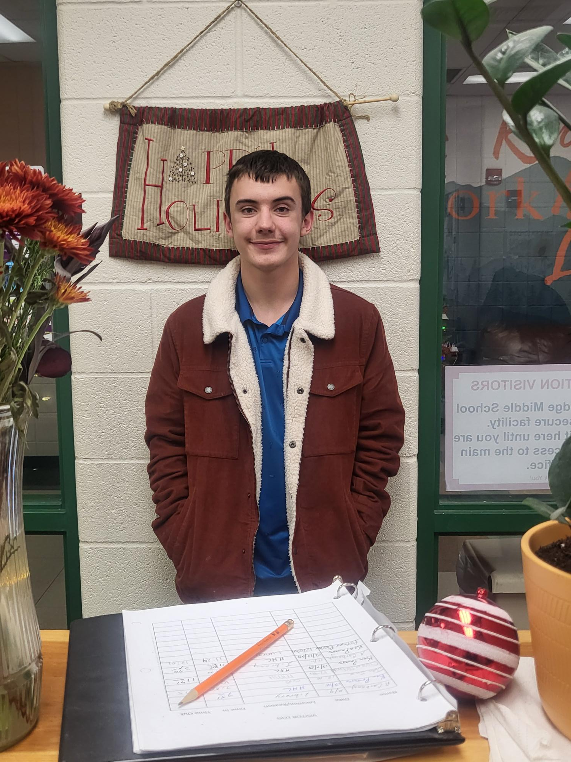
Phoeniz Fox – 7th Grade Capon Bridge Middle School
Phoenix is Always prepared, always makes his best effort, always helpful, and always attentive! We are so proud to honor Pheonix with this month's CAKE award for the 7th grade!

Slide 12
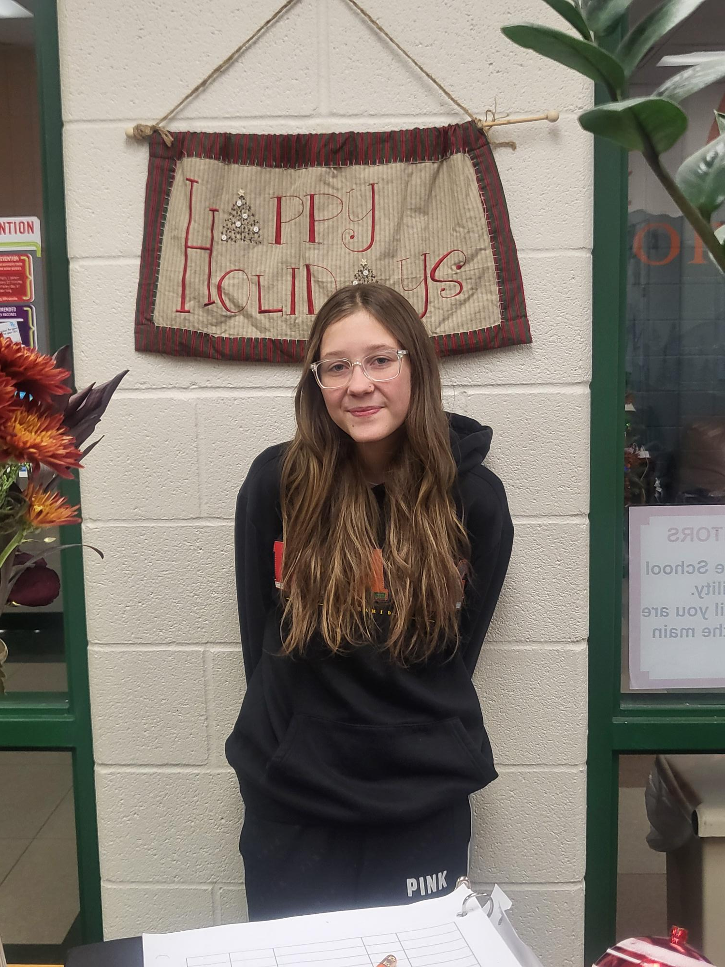
Abrianna Miller – 8th Capon Bridge Middle School
Abrianna has immensely put a ton of work and heart into improving her grades, as well as making a ton of growth in her iReady testing. She has made it a point to ask questions, check her work, isn't afraid to ask for help, puts pride into her effort, plans ahead for assignment needs and deadlines for her classes, supports her classmates, and gets so excited about the results of her hard work. Her teachers are so proud of how hard she has worked and that she also will help others to bring their best efforts as Bobcats at CBMS! Abrianna has been a PAWesome Bobcat!

Slide 13
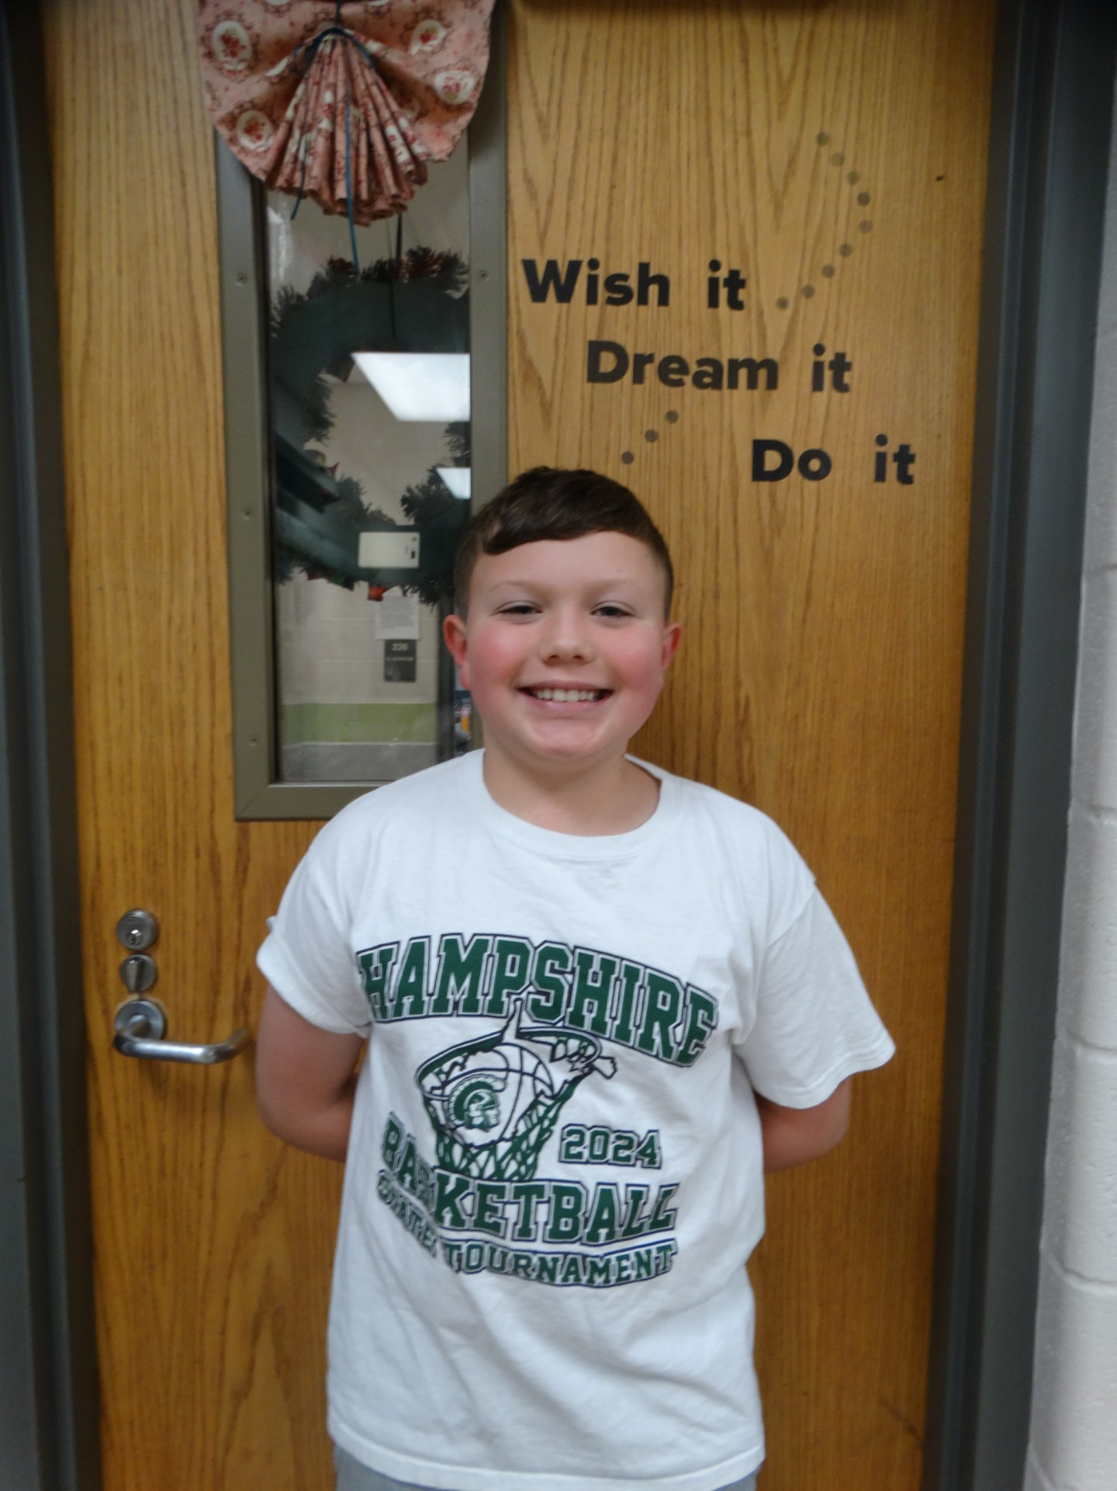
Wyatt Shoemaker – 6th Grade Romney Middle School
Wyatt is sweet tempered and conscientious with his studies. He is a super volunteer. As a member of Student Council, Wyatt has pitched in to make the Romney Middle School Santa Shop a success. He also helps keep the hallway looking great by generating ideas and creating monthly bulletin boards. Wyatt is always willing to lend a hand with a smile on his face.

Slide 14
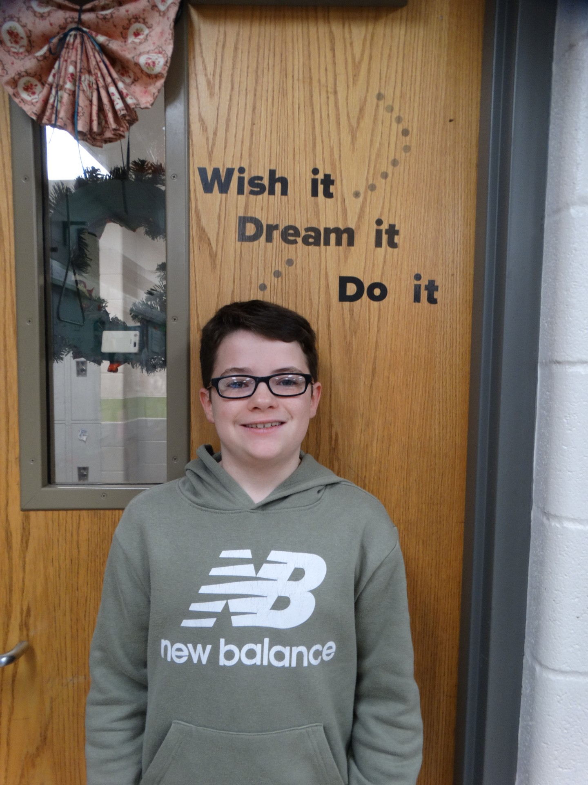
Peyton Daugherty – 7th Grade Romney Middle School
Peyton is respectful, kind, and well mannered. He excels in the classroom and is a role model for others. He is self-motivated and always does his best. On his i-Ready Diagnostic taken early this month, he showed tremendous growth in both ELA and Math.

Slide 15
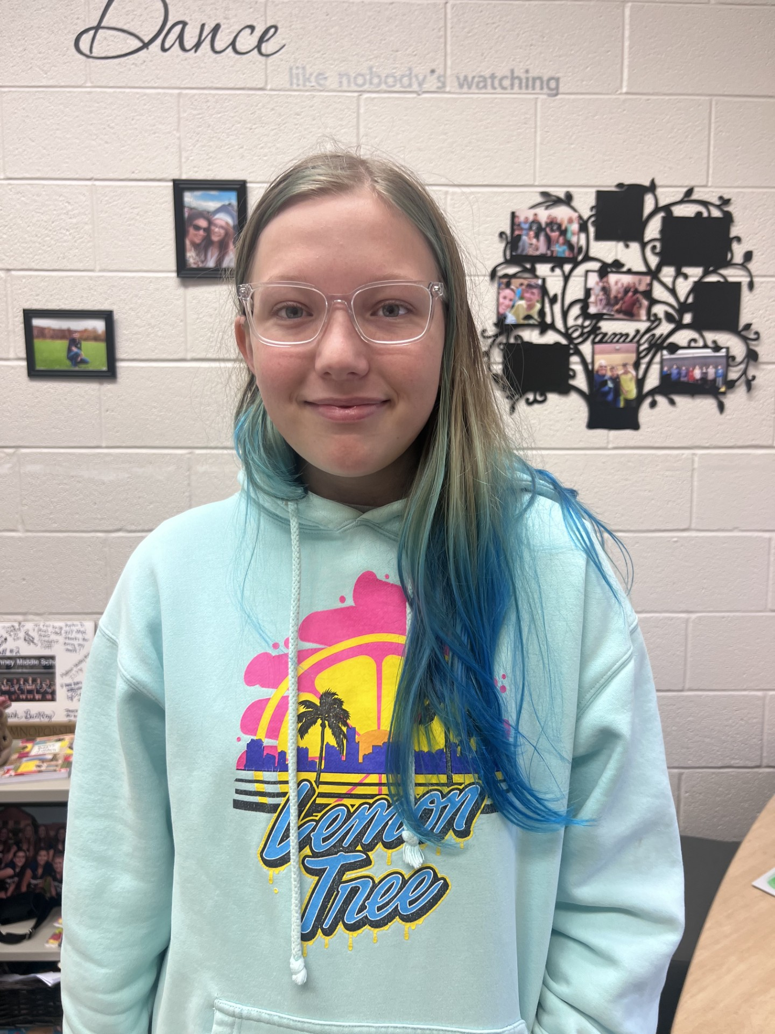
Daphane Frantz – 8th Grade Romney Middle School
Daphne – has a positive attitude, works hard and perseveres. She remains on task throughout class and is always willing to help others. She is an excellent role model for her peers. She completes class work thoroughly and is always polite and kind.

Slide 16
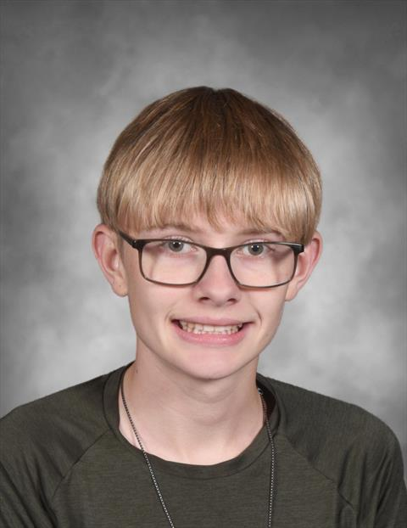
Landon Ratliff – 9th Grade Hampshire High School
Landon is super respectful at all times. He works hard in his classes and treats everyone with respect. He is quiet and has a great sense of humor. He does his work without complaint and participates in class. He is willing to go above and beyond to help teachers and other students. I couldn't ask for a nicer kid to have in class.

Slide 17
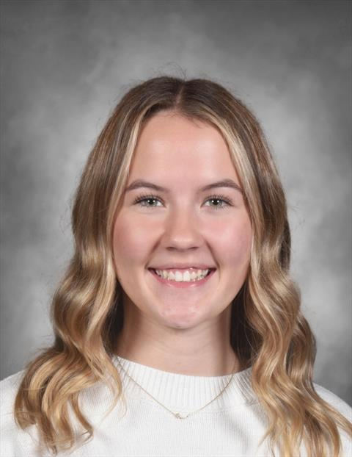
Ava Gray – 10th Grade Hampshire High School
Ava is a dedicated student, devoted athlete, and an all-around wonderful, polite young lady. Ava goes above and beyond in her studies and even finds time to help others when they are struggling. Ava is always quick to offer a helping hand to staff and students, whether it be in yearbook class, the school coffee shop, or anywhere else on campus! She volunteers her time to do anything that needs to be done in her extracurricular activities - and she does all of this with a great big, genuine smile on her face!

Slide 18
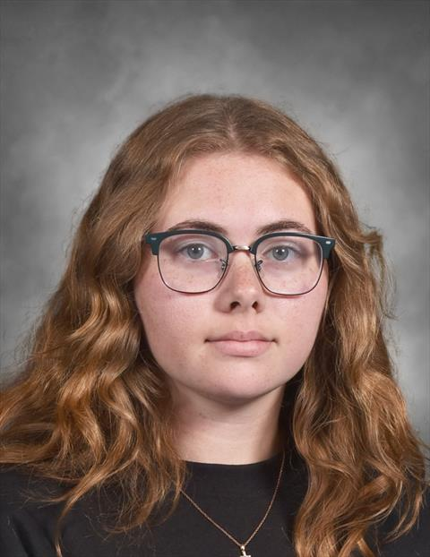
Hailey Hirsch – 11th Grade Hampshire High School
Hailey is a wonderful student. She always does her work in class and does it well. She has a quiet demeanor and flies under the radar but is an excellent addition to HHS. She takes honors classes and has all A’s. She is an integral part of jazz band, too. We wish more students took academics as seriously as Hailey.

Slide 19
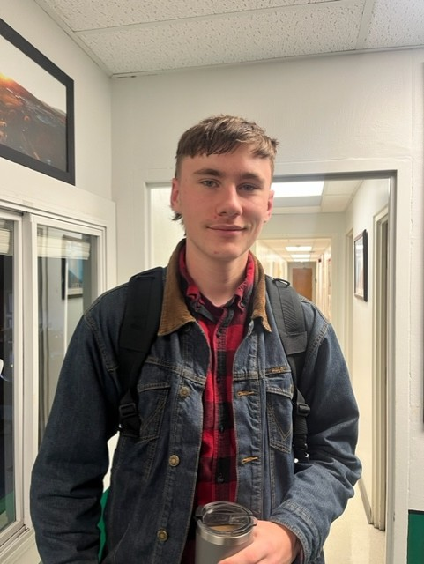
Bodie Stankwich – 12th Grade Hampshire High School
Bodie is an intelligent young man who often goes unnoticed. He always gets his work done in a timely, professional manner and maintains an A average in all classes. He is very polite and friendly and will do anything that is asked of him. He has impeccable manners when talking to adults which is a rare trait in today’s world.

Slide 20
Congratulations!!!

