Slide 1
Smart Schools Bond Act & Smart Schools Investment Plan
Public Hearing
April 16, 2019

Slide 2


Smart Schools Bond Act
Project So
The Smart Schools Bond Act of 2014 was passed in the 2014-15 Enacted Budget and approved by the voters in a statewide referendum held during the 2014 General Election on Tuesday, November 4, 2014
The Smart Schools Bond Act (SSBA) authorized $2 billion to finance improved educational technology and infrastructure throughout the State

Slide 3
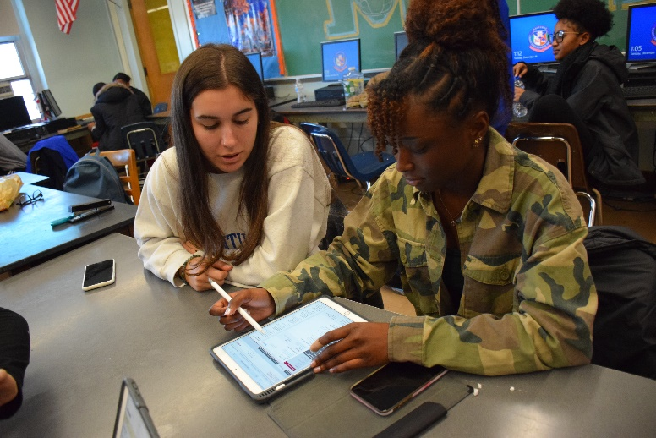
Malverne UFSD Allocation
Total Allocation
  $982,533
The District submitted and received approval on its first plan in June 2018
  Plan 1 – Expended $114,167.89
  Funds spent on school connectivity
Plan 2 submission
  868,363

Slide 4
Allowable Smart School Bond Expenditures
  Install high-speed broadband or wireless internet connectivity
  Acquire learning technology equipment or facilities (devices)
  Construct, enhance, or modernize educational facilities to accommodate prekindergarten programs and to provide instructional space to replace classroom trailers
  Install high-tech security features in school buildings and on school campuses
    Including but not limited to video surveillance, emergency notification systems, and physical access controls

Slide 5
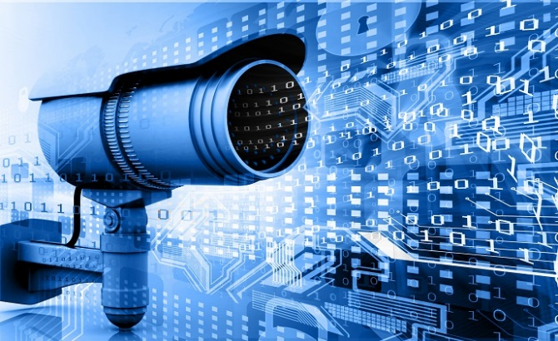
Smart Schools Bond Act and Smart Schools Investment Plan Overview
Installation of High Tech Security Features
Utilize funds to secure all exterior doors
Utilize funds to continue installation of high definition video surveillance equipment and software

Slide 6
Utilize funds to secure all exterior doors
Rationale:
The current system to enter and exit buildings needs to be expanded. The District must keep all exterior doors locked at all times but allow employees of the District to gain easy access by utilizing an identification card reader. There is also no way to physically activate a lockdown.
Proposed:
The District is proposing to expand implementation of identification card reader system. The new system will be installed at all exterior and select interior doors throughout the District. In addition panic buttons will be strategically installed throughout the District.
Cost:
The expected total costs of this recommendation is $150,744.55 to be funded via the SMART Schools Bond.

Slide 7

Utilize funds to continue installation of high definition video surveillance equipment and software
Rationale:
Many older video cameras do not provide enough clarity and/or coverage in the District. In addition, older software does not allow viewing of multiple cameras at the same time.
Proposed:
The District is proposing to purchase and install approximately 286 new hi-definition megapixel cameras and update video surveillance software.
Cost:
The expected total costs of this recommendation is $717,618.45 to be funded via the SMART Schools Bond.

Slide 8
The Smart Schools Investment Plan (SSIP) Approval Process
SED Staff Review and Approve Plan
SSBA Review Board Review and Approve Plan
District Begins Project(s)
District Submits Reimbursement Request(s)
SED/State Reimburses District
District Submits Final Plan
[START]

Slide 9
Timeline
The District continues to make submissions to the State Education Department SSBA Program for our SSBA Allocation and Projects. Once the Investment Plan is approved by the State, the District will begin necessary preparations to begin the installation of high tech security features. Actual dates are to be determined as this project requires pre-approval by the New York State Education Department prior to the start of work.
After the approval of the plan the District will begin to make purchases.

