Slide 1

THANK
YOU!
GROSSE ILE TOWNSHIP SCHOOLS

Slide 2

The Grosse Ile Township Schools
Board of Education has placed a
Building and Site Sinking Fund Millage Renewal Proposal
on the August 6, 2024 ballot.
GROSSE ILE TOWNSHIP SCHOOLS

Slide 3
This Sinking Fund millage is about…
Updating instructional technology
Improving the student learning environment
Updating school facility interiors/exteriors
Enhancing student safety and security
GROSSE ILE TOWNSHIP SCHOOLS

Slide 4
The Building and Site Sinking Fund Millage Renewal Proposal will continue providing revenue for the school district to make infrastructure improvements and repairs to district facilities and any other purpose allowed under Michigan law.
GROSSE ILE TOWNSHIP SCHOOLS

Slide 5
The Building and Site Sinking Fund Millage Renewal Proposal
Is a five-year, .9781 mill, renewal proposal that will allow Grosse Ile Township Schools to continue to levy a building and site sinking fund millage. There is no increase in the millage rate
  The current sinking fund expires in December, 2024.
GROSSE ILE TOWNSHIP SCHOOLS

Slide 6
Grosse Ile Township Schools have had a sinking fund since 2006.
The sinking fund was renewed in 2010, 2015, and again in 2020.
GROSSE ILE TOWNSHIP SCHOOLS
RICHMOND COMMUNITY SCHOOLS

Slide 7
In previous years, sinking fund revenue has provided funding for facility repairs, renovations, replacement projects and more recently (within the last 5 years) technology enhancements within the district.
GROSSE ILE TOWNSHIP SCHOOLS

Slide 8
In the last five years, sinking fund projects have included:
Repair roofs
Improvement of HVAC systems
Replacement/repairs of chiller systems
Electronic gate/fencing for transportation yard
LED lighting
Vape Detectors
Security Cameras
Repair Baseball/Softball Sheds
Middle School Art Room rebuild
Uninterrupted Power Supply units
Core Edge Switches
Lighting for High School Auditorium
Replacement of Middle School Boiler
Repair of masonry wall at Parke Lane Elementary
GROSSE ILE TOWNSHIP SCHOOLS
RICHMOND COMMUNITY SCHOOLS

Slide 9

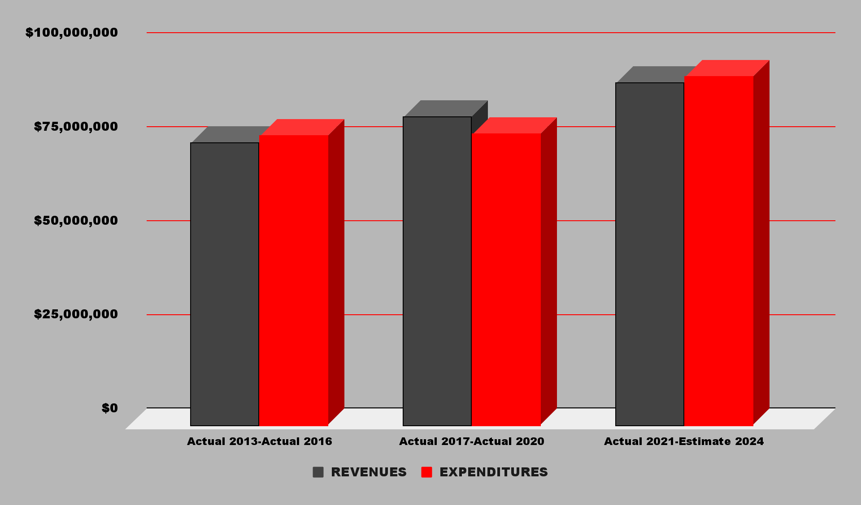
GENERAL FUND: Revenues vs Expenditures
2013 through 2023
GROSSE ILE TOWNSHIP SCHOOLS
RICHMOND COMMUNITY SCHOOLS

Slide 10
Sinking Fund | Bond Fund | General Fund
Future repairs, renovations and replacement of capital expenses and improvements. Funding for maintenance and repairs of existing school facilities. More recently allows for technology upgrades such as server upgrades and network infrastructure. | Bond dollars in schools are allocated for specific capital projects and improvements. They fund major renovations and construction of new school facilities. Bond dollars also support technology integration and equipment upgrades across schools. | General fund dollars in schools are used for day-to-day operational expenses. They cover salaries and benefits for teachers and staff. Used for purchasing educational materials, textbooks, and supplies. Funds maintenance and utilities for school buildings. Also supports extracurricular activities and transportation costs for students.
GROSSE ILE TOWNSHIP SCHOOLS
RICHMOND COMMUNITY SCHOOLS

Slide 11
You can vote on August 6, 2024 at your regular polling place or by absentee ballot now through Election Day.
GROSSE ILE TOWNSHIP SCHOOLS
RICHMOND COMMUNITY SCHOOLS

Slide 12
For more information go to
www.gischools.org
Then click on
2025 School Sinking Fund Election
GROSSE ILE TOWNSHIP SCHOOLS

Slide 13
Or, call Interim Superintendent of Schools
Audrie Kalisz at 743.362.2555
or by email at
kalisza@gischools.org
GROSSE ILE TOWNSHIP SCHOOLS
RICHMOND COMMUNITY SCHOOLS

Slide 14
THANK
YOU!
GROSSE ILE TOWNSHIP SCHOOLS
RICHMOND COMMUNITY SCHOOLS

