Slide 1

K-12 Computer, Technology, Engineering
A.Coots
9/12/23

Slide 2




Elementary
Computer, Engineering, Tech. STEM
Integrated across classes K-4
  Similar to R/W
Explicitly taught in some lessons with K-4 Library Science
  Increment- 40 min. for 1 period each week
Explicitly taught in K-4 Elementary Computer Teacher
  Increment- 40 min. for 1 period each week
STEM Coach
  Title IV funded
  STEM: Engineering, Coding

Slide 3
Middle School
Computer, Engineering, Technology, STEM
Integrated across classes 5-8
  Similar to R/W
  M, ELA, SS, Science
Explicitly taught in 5-8 Computer Teacher
  Increment- 40 min. period each week (Approx. 9wk./Special- every student has approx. 60 days)
  Computer 5,6,7,8
List other areas
  STEM 5 and 6
  Shop Skills 6,7,8 and Shop Extensions
  STEM: Engineering, Coding
  Personal Finance 8
Notes:
STEM and Shop Skills – Mr. Erwad

Slide 4
High School: C,E,T, STEM
Integrated across 9-12 courses
  Similar to R/W and CTW Standards
  All contents
Explicitly taught in HS Computer Teacher (75% Business/25% Tech.)
  Increment- 40 min. period each day
  Current Courses: Web Design, Computer Technology, Business Law, Business Management, Accounting 1, Financial Record Keeping, Computer Programming, Computer
Other Courses:
  Yearbook, Journalism, Film and Society, Sports, Justice Education
  Biology, Anatomy & Physiology, Science & Technology, Robotics, Earth and Space
  Personal Finance (CTW), Fundamentals of Science, Probability and Statistics, Environmental Science, Algebra, Geometry, Adv. Algebra, Pre-Calc., Calculus, DE College Algebra
  Dual PCT: Power Tools, Engineering, Serve Safe, Horticulture. ESP: Into. Statistics, Management Principles, Principals of Accounting II, Principals of Microeconomics, Survey of Mathematical Ideas. LCC: Intro. To Business, Operating Systems Fundamentals, Macroeconomics, Microeconomics, Principles of Marketing, College Algebra, Intro. Stats. & Data, Intro. To Sports Management, Information Technology Management
Notes:
HS Computer Teacher Certification: k-12 Business Computer Information Technology

Slide 5

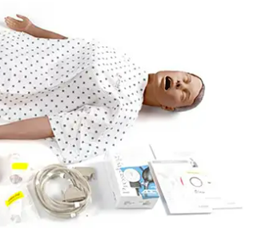
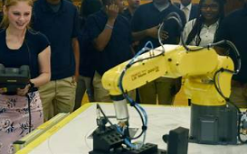
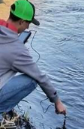
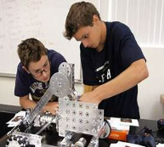
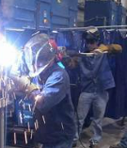
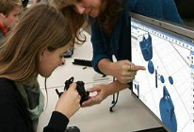
CTE-STEM in our HS
Notes:
HS Computer Teacher Certification: k-12 Business Computer Information Technology

Slide 6
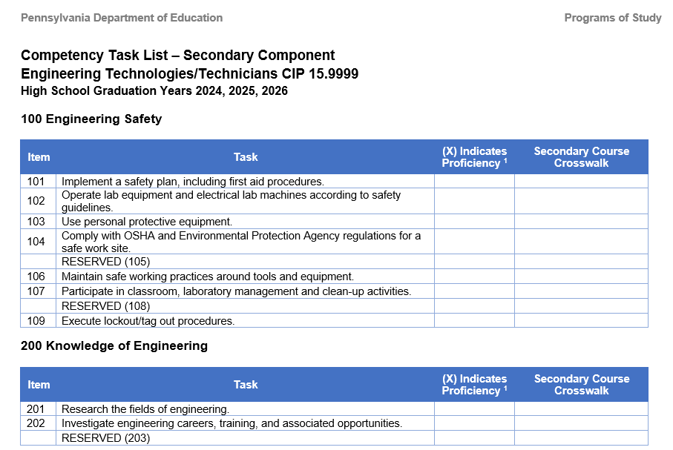
High School: Engineering POS
Notes:
Linked task grid to title an chart.

Slide 7
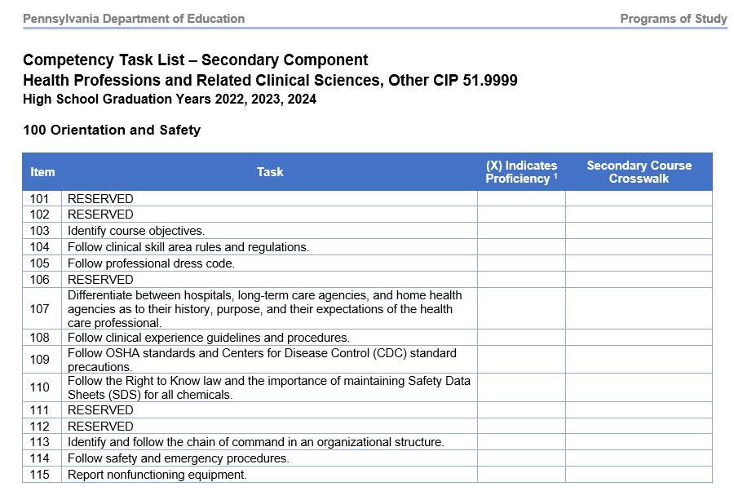
High School: Health Occupations
Notes:
Task grid is link to the title and the grid

Slide 8
High School: Aviation
Content:
Introduction to Aviation and Aerospace
Overview of Commercial, Military, and General Aviation
Introduction to Unmanned Aircraft Systems
Introduction to Space Exploration
Aviation’s Primitive Beginnings (DaVinci/Greek)
Hot Air and Gas Ballooning
Glider Flight and Early Innovators
Powered, Controlled Flight
First Practical Applications of Airplanes, Commercial and Military
Women in Early Aviation
Aviation Innovation and World War II
Development of the Jet Engine
The Space Race
Modern Aircraft Design-Navigation, Composites and Structures
Categories and Classes of Aircraft, UAS
Design Considerations for Aircraft
Manned and Unmanned Aircraft Components
Aircraft Construction
Air is Fluid, Air Density, Density Altitude
Forces of Flight (Vectors, Airfoils, Lift Production, Aerodynamic Stalls, Weight & Balance)
Stability Design and Rotorcraft Lift
Primary and Secondary Controls
Structural Loads
Career/job Application
Weather and the Atmosphere
Aviation Weather Observation and Forecasts
Airport Markings, Signs, Data, & Communications
Aeronautical Charts and Airspace Systems
Instrument Flight
Commercial Aviation
Advanced Aircraft Systems
Drones, UAS
Aviation Entrepreneurs & Business Plan

Slide 9

Standards:

Slide 10
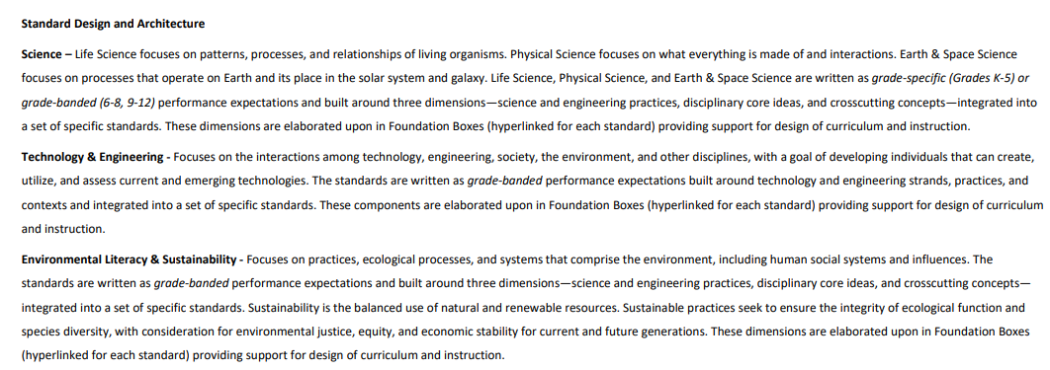
STEEL Breakdown:

Slide 11
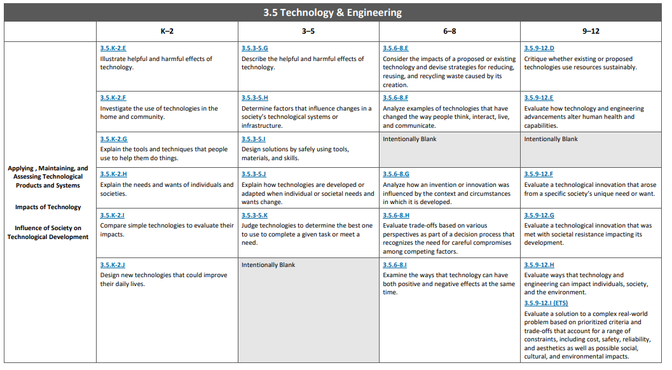
STEEL Grade Bands- Example

Slide 12
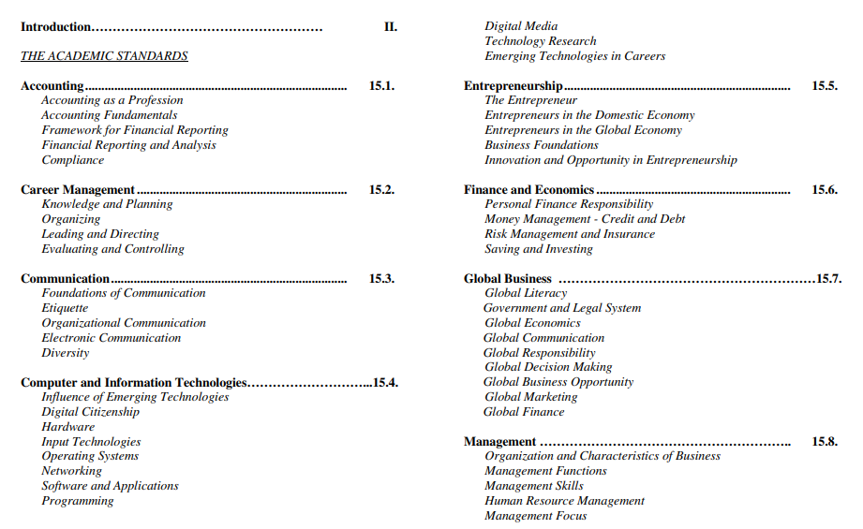
Business, Computer, and Information Technology Standards K-12 of 2012

Slide 13
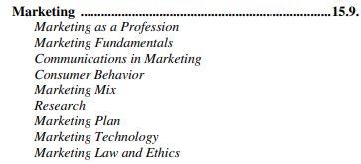
Business, Computer, and Information Technology Standards Continued-

Slide 14
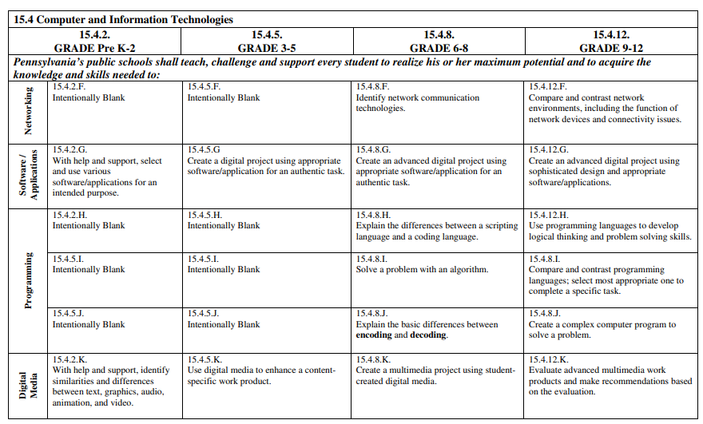
Business, Computer, and Information Technology Standards Example

Slide 15
Other Standards
Career to Work Standards https://www.stateboard.education.pa.gov/Documents/Regulations%20and%20Statements/State%20Academic%20Standards/Career%20Education%20and%20Work%20Standards.pdf
Economics- Begins in 3rd Grade https://www.stateboard.education.pa.gov/Documents
Reading, Writing, Speaking and Listening Grades 3-8 http://static.pdesas.org/content/documents/Academic_Standards_for_Reading_Writing_Speaking_and_Listening_(Elementary).pdf
Internet Safety CIPA

Slide 16

Take away-
Meet with MS Computer Teacher
  Horizontal Curriculum
  Vertical Curriculum
At the conclusion of 2023-24 SY reflect upon the draft curriculums and revise
Attend PETE&C- Foster collaboration in the K-12 continuum
Mindful –Teachers with 7-12 Certifications may be significantly difficult to find

