Slide 1

PIGGOTT MOHAWKS
Piggott Public Schools
2024
Annual Report to the Public
October 8, 2024

Slide 2
OUR MISSION
The faculty and staff of the Piggott School District believe that all students can learn and master basic academic skills regardless of their previous academic performance, family background, socio-economic status, race, or gender. The faculty and staff accept the responsibility for providing strong instructional leadership, a positive school climate, and a safe and orderly school environment. We foster strong parent and community involvement.

Slide 3
SCHOOL BOARD MEMBERS
President-- Jennifer Rahn
Vice-President-- Jacob Richardson
Secretary-- Rob Chandler
Member-- Fallon Winscott
Member-- Kristin Crittenden

Slide 4
Staff Information
Classified Employees--58
Licensed Employees--73
Bachelor of Science in Education-34
Master of Science in Education--37
Educational Specialists–2
National Board Certified--0
Total Employees–131

Slide 5
Enrollment
As of October 6, 2024
Kindergarten--55 7th--50
1st-- 68 8th--65
2nd-- 62 9th--75
3rd-- 58 10th--53
4th-- 57 11th--48
5th-- 58 12th--39
6th-- 52
Elementary Enrollment– 410 High School Enrollment– 330 Total Enrollment–740

Slide 6
Taxpayer Information
Millage Rate
Piggott Public Schools 35.44/State Average 39.15
Piggott School Average Teacher Salary/Arkansas Average Teacher Salary
$54,385.84/$55,193
Expenditure Per Pupil–$9,672

Slide 7
Taxpayer Information
2023 Assessment--$90,830,667
Legal Balance(w/categorical funds)--$1,490,216.46
Salary & Benefits(all sources)--$7,326,583.44
Debt Service Expenditures--$348,652.50
State Foundation Funding Aid--$3,712,159

Slide 8
Federal Programs
Title I--Preliminary Allocation--$355,441.58
Salaries and Benefits for Reading Recovery Specialists, Federal Programs Coordinator, Supplemental Material, Technology, and Instructional Assistants
Title VI-B–Special Education–$213,078.57
Salaries and Benefits for paraprofessionals, general supplies, and PT/OT and Speech Therapy
Federal Preschool Special Education–$13,034.40
These Funds are handled through the Northeast Arkansas Coop

Slide 9
Federal Programs
Title II-A
Preliminary Allocation--$50,328.95
These funds are transferred to Title I and are used as stated on last slide
Rural and Low Income Schools–$27,838.41
Supplemental Material and Tutoring
Title IV–$17,982.59
These funds are transferred to Title I

Slide 10
Piggott School District Facilities
The School District operates on two campuses.
Elementary School and High School Campuses total 234,893 square feet of building space that require maintenance and operation efforts.
206,892 square feet of academic space
28,001 square feet of non-academic space

Slide 11
Facility Projects & Future Plans
* New Roof for Old Gym–We have been approved for partnership funds and will find out the awarded
Amount in May of 2025. We are in the process of getting cost estimates for the project at this time.
* New Safehouse at Elementary School–will apply for federal funding when FEMA funds are available
* Opened Lil Mohawk Daycare August 2024 with 14 students ages 6 weeks to 36 months
* Upgraded phones system Summer of 2024
* Upgraded Technology Switches Summer of 2024
* Possible relocation of HS Office
* Future Projects on our 10 year plan include an Auditorium and Safe House for Elementary School Campus

Slide 12
Food Service--2023-2024
Meals Prepared per School Day
Breakfast--335/day
Lunch--570/day
We highly encourage families to apply for free and reduced lunches for this school year. Breakfast charges for the 2024-25 school year will be $1.65 and lunch will be $2.95. If our district reaches the 70% FRL threshold, then all students would be eligible for free meals.
We are currently at 65.5% FRL.
Hope Burns–Food Service Director

Slide 13
IT Department
The Piggott School District has an Internet Safety and Electronic Device Policy, we use a state provided internet content filter for our internet access.
The Piggott School District has available about 1000 student devices(chromebooks) and 230 teacher/staff devices throughout the district.
Telephone Systems were upgraded during the Summer of 2024
New Switches were installed during the Summer of 2024

Slide 14
Transportation
Buses--14
Route Drivers--9
Routes--9
Daily Average of Students Transported--410

Slide 15
Piggott High School
Race/Ethnicity Statistics
African American--0.6%
Hispanic/Latino--2.6%
White--94.8%
Two or more Races--2.0%
Asian–0.0%
American Indian–0.0%
School Characteristics
Enrollment 343
Avg. years teaching Experience 15.22
Student to Teacher Ratio: 10:1
Economically Disadvantaged: 58%
Students With Disabilities: 12%

Slide 16
Piggott High School
2024 Graduates--52
Honor Graduates--6
Average ACT Scores @ PHS– for all PHS participants; for PHS students that are attending college/university

Slide 17
Piggott High School–Literacy Program
7th and 8th have a year long reading class. They are using the CKLA curriculum for the third year.
My Perspectives is being used in 9-12 grades. It is the second year that these grades are using this curriculum.
We are using IXL as a supplemental program in grades 7-12 to offset learning loss.
The STAR test is being used to determine reading level, as well as growth from the beginning of the year to the end.
The ATLAS writing pilot was just finished for grades 7-11. Because we piloted the test, we have a set of classroom tools available to use - bank of questions, access to assessments that are of the same format as the test, etc. The science pilot will be given later this month.

Slide 18
PHS
2024-2025 Advanced Placement Courses--AP Art, AP Art Drawing, AP Art 2D, AP Art 3D, AP English, AP Science, AP History. College Algebra and Biology are offered on Campus with face-to-face instruction. Students can take courses such as Composition, Psychology, Speech, and U.S. History for concurrent credit.
Student Participants--11 Students
Extra Curricular Activities--Athletic--Football, Volleyball, Tennis, Golf, Basketball, Track and Field, Baseball, Softball, ESports, Band, Choir, and Cheerleading. Academic events--FFA, FBLA, Mid-level FBLA, FCCLA, Art Club, Junior Historians Society, BETA, Spanish Club, Chess Team, and PACE.

Slide 19

Black River Technical Center at The Armory
18 Students currently enrolled in two vocational programs:
Industrial Electrical
Welding
This our second year of the BRTC partnership.

Slide 20
FBLA
Stacy Peters–Senior High Advisor

Slide 21


Slide 22
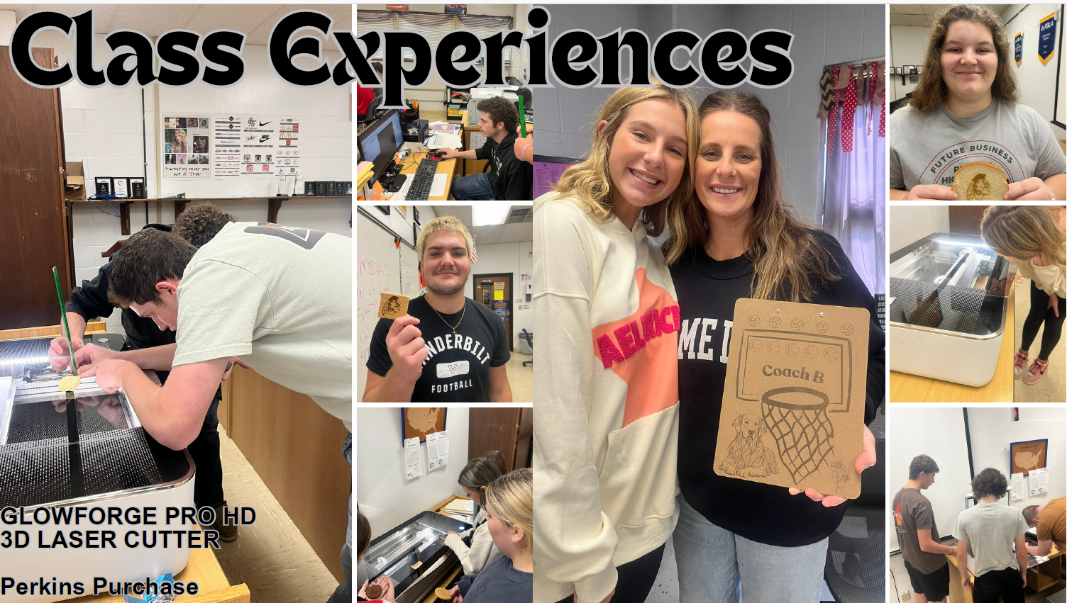

Slide 23
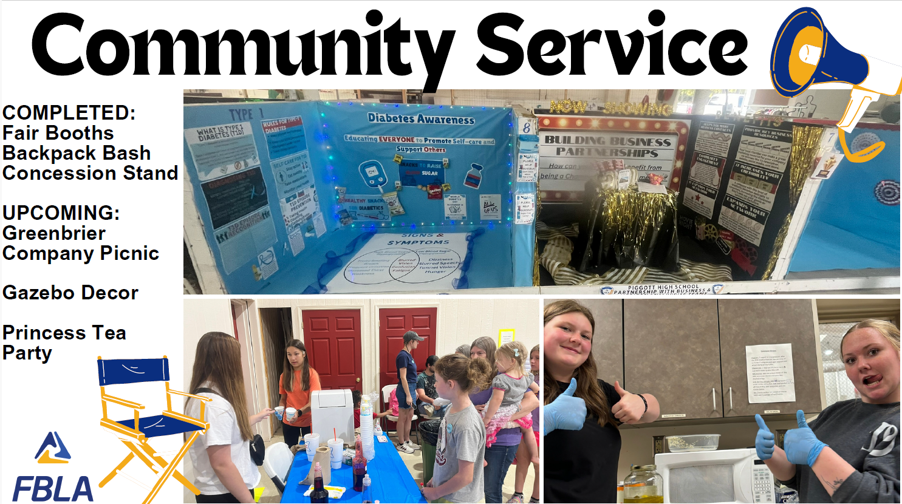

Slide 24
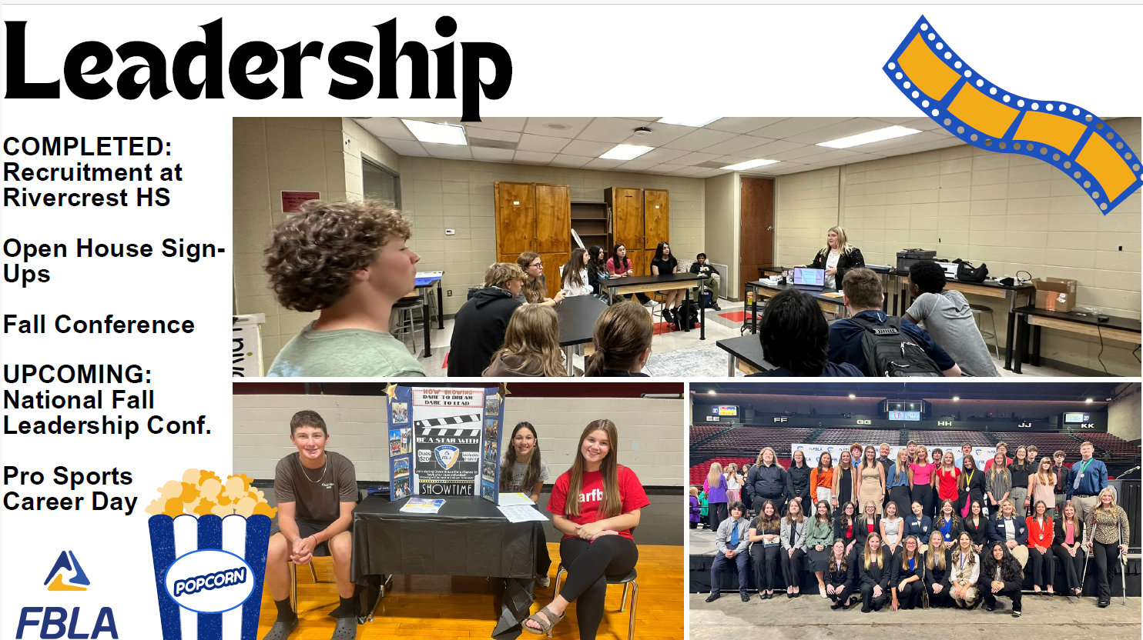

Slide 25
FBLA
Survey of Business students are taking the Microsoft certification test, with 8 students earning the industry-recognized credential at this point.
The Organizational Leadership class is working with the Chamber of Commerce to put together a video presentation about the history of Piggott that will be shown at the Chamber Banquet celebrating the city's sesquicentennial.
Taylor Peters and Charlie Latta placed 7th in the Nation.

Slide 26
PACE
Cassie Knight–Facilitator

Slide 27



Piggott PACE
PROGRAM FOR ACADEMIC AND CREATIVE EXCELLENCE

Slide 28




All students in kindergarten - second grade receive enrichment (Discovery) class each week. These classes focus on skills such as critical thinking, problem solving, STEM, and creativity.
Students who are identified begin small groups in 3rd grade.
Currently Piggott School District serves 30 students in 3rd-6th grade and 43 high school students.

Slide 29

Program Options
High school students are served through advanced and college level courses. We also offer a GT Seminar class which is project based and focuses on higher level thinking, research, and creativity.
Grades 3-6 identified students are served in small groups for a minimum of 150 minutes each week. I focus on higher level thinking and students work on a variety of projects throughout the year. I try to coordinate activities around topics and skills from the regular classroom as well as acceleration of topics.

Slide 30
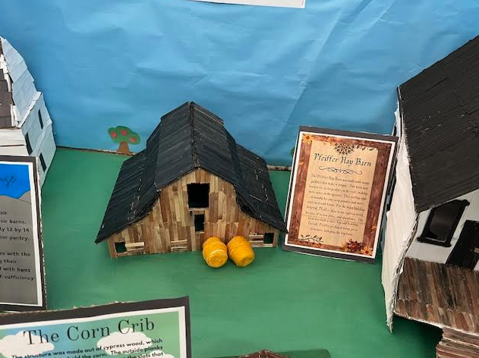
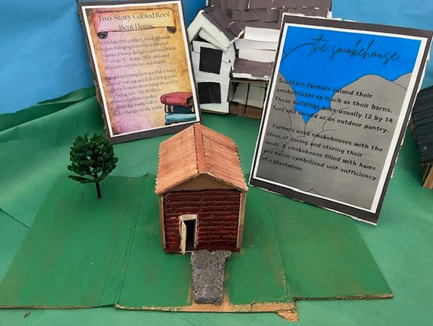
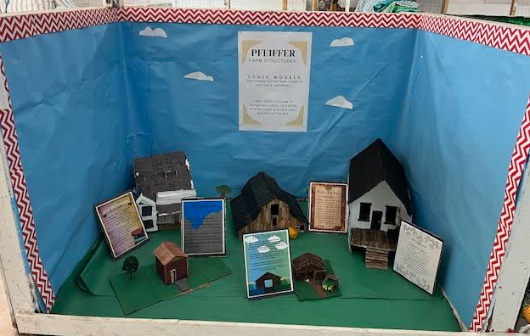
GT Seminar Fair Project
Pfeiffer Farm Structures

Slide 31
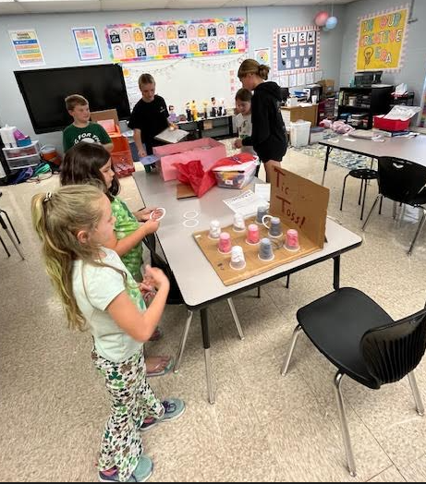
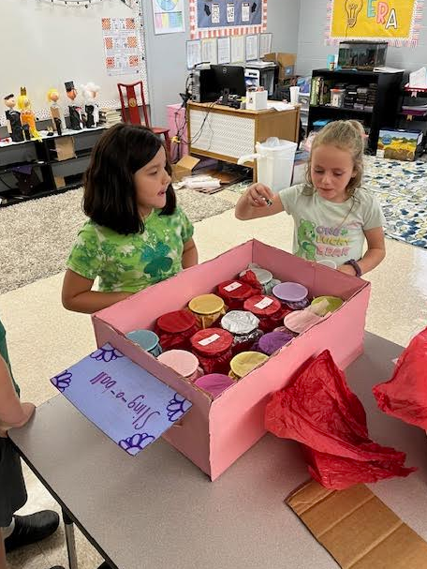
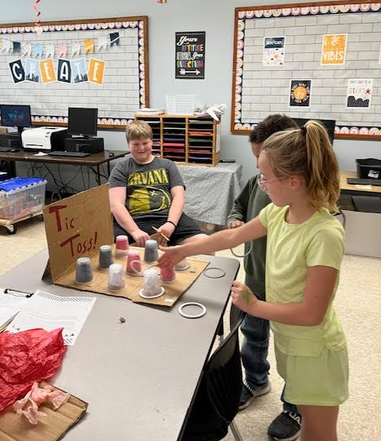
6th Grade Carnival Project
Students created a game, calculated price points, collected data, and determined if their game was profitable.

Slide 32
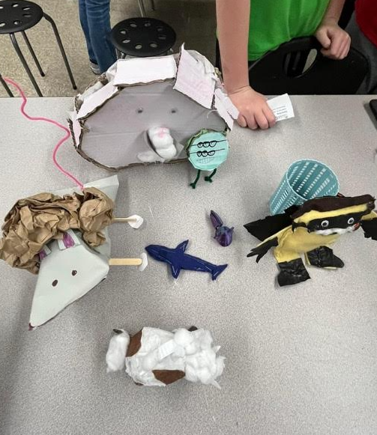
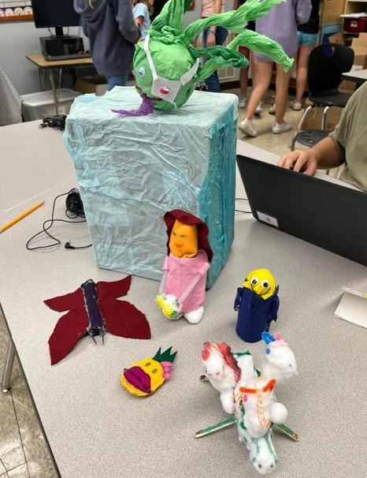
5th Grade Creative Writing/ Doodle Project

Slide 33
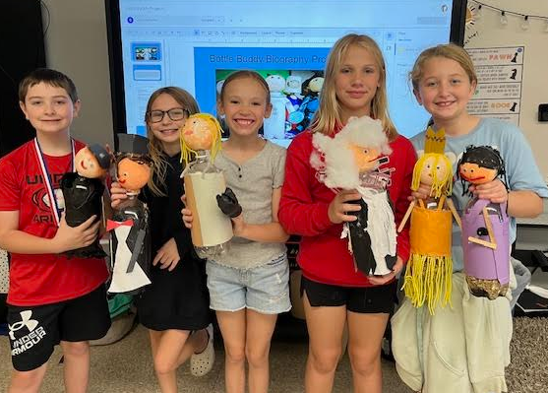
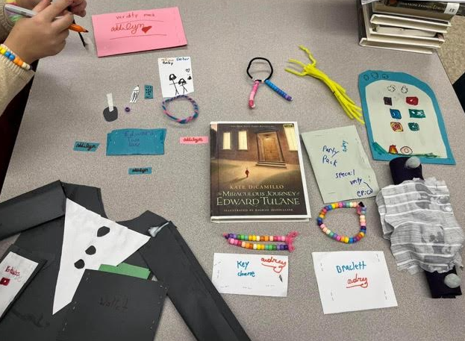
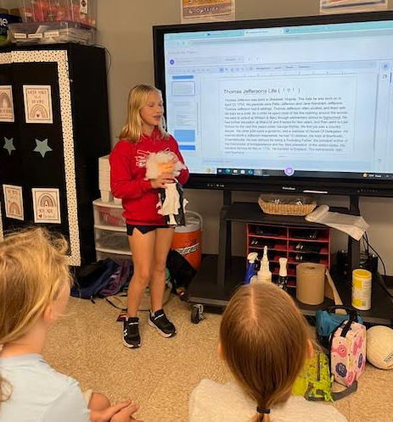
4th Grade Bottle Buddy
3rd grade Book Study:
Miraculous Journey of Edward Tulane

Slide 34
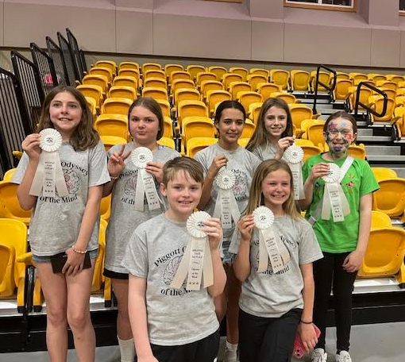
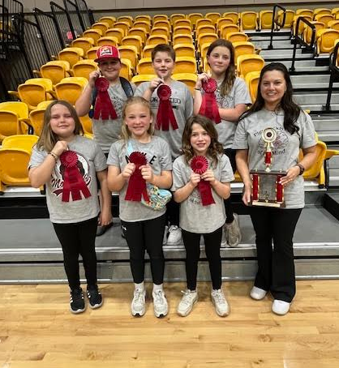
Odyssey of the Mind State Tournament
April 2024

Slide 35
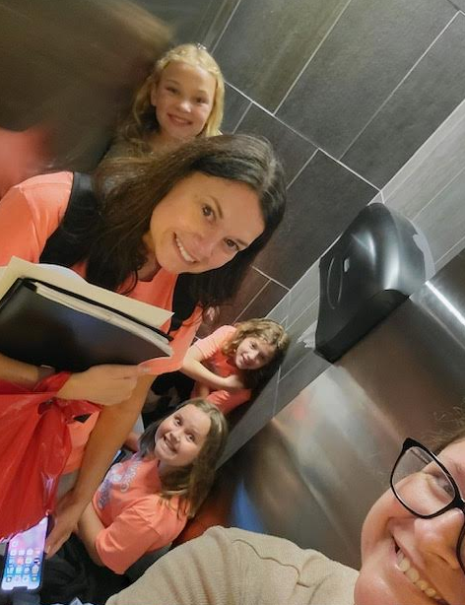
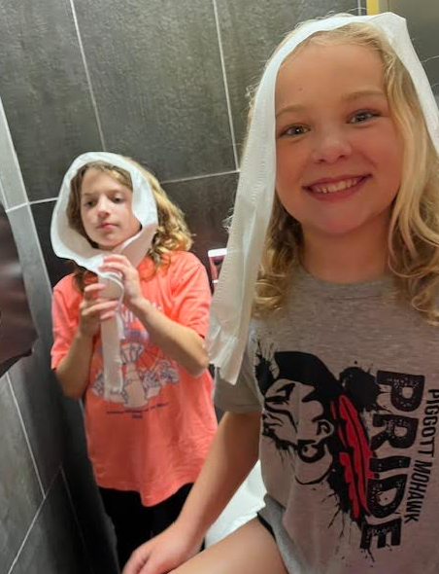
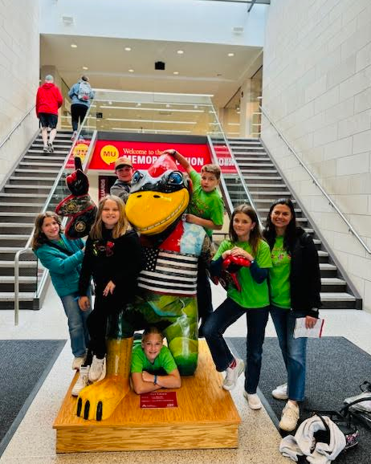
Odyssey of the Mind
World Finals
Ames, Iowa
May 2024

Slide 36
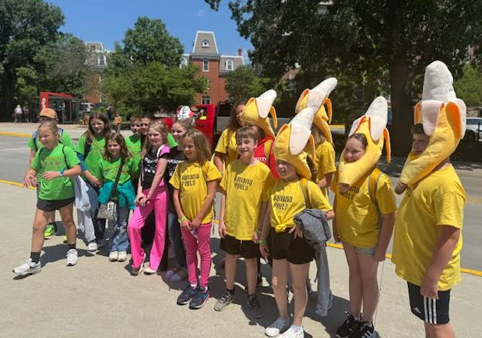
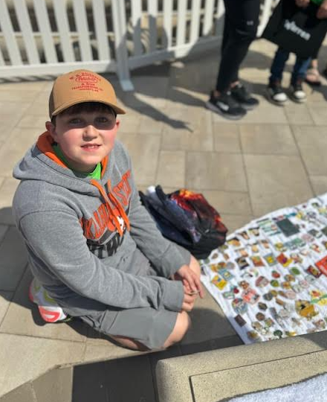
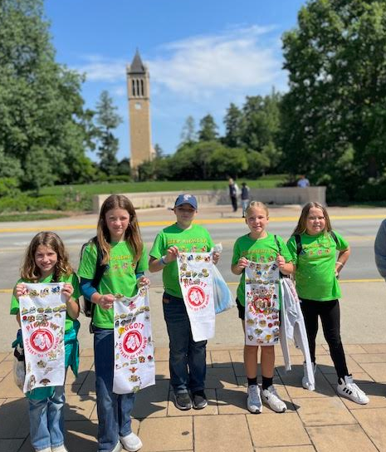

Slide 37
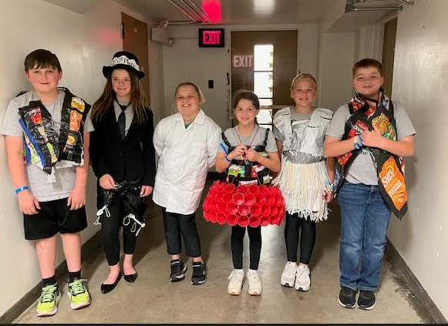
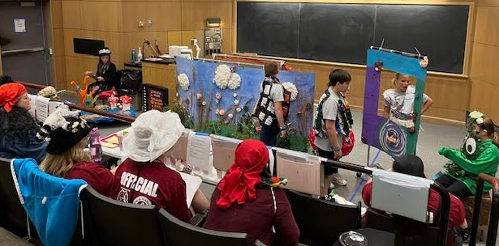
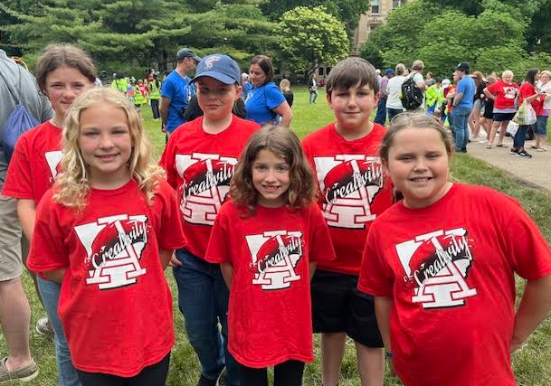

Slide 38
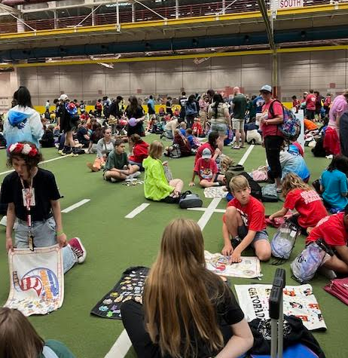
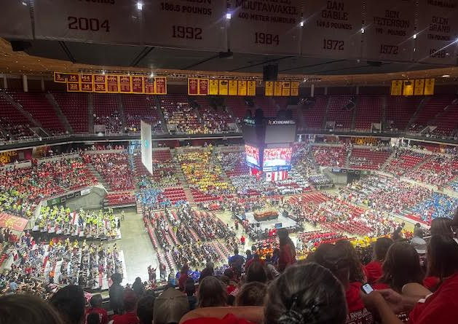
They placed top 20 (17th) in their age division. There were five countries represented.

Slide 39
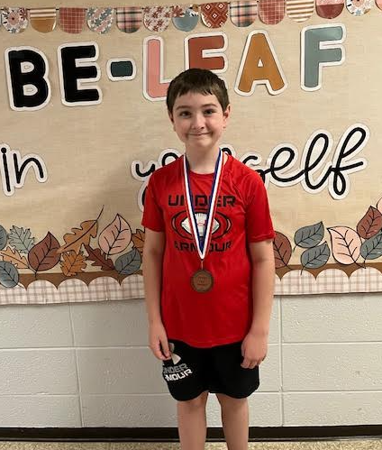
2024 AAIMS Media Festival Winners
9-12 Animation
2nd place Chloie Foster
6-8 Animation
1st place Gretchen Simpson and Madelyn Knight
Color photography
3rd place Khloe Langley
2nd place Shiloh Rouse
Ryan Crittenden
3rd place animation

Slide 40
Piggott Elementary–My School Info 2023-2024
School Characteristics
Enrollment 430
Avg. years teaching Experience 10.6
Economically Disadvantaged: 68%
Students Eligible to Receive Special Education–27%
Race/Ethnicity Statistics
African American-- 1.2%
Hispanic Latino-- 0.5%
White--97.2%
Two or More Races–0.9%
American Indian–0.2%

Slide 41
PES
Instructional Material--Lexia Core 5(K-5), Lexia Power Up(6), iXL--English and Language Arts, HMH Into Math, Reading Eggs, Starfall, Core Knowledge Language Arts
Take Flight for Dyslexia Instruction
Programs offered--Art, Music, PE, Group Guidance, Enrichment, Computer Lab, and Library. PeeWee Sports of football, volleyball, and basketball.

Slide 42
District State Test Scores
District Test Scores from 2023-24 Atlas Testing Not available at this time.
Scheduled to Receive Scores 10/14/24.
School Letter grades will not be given until Spring of 2025

Slide 43
ESSA Scores

Slide 44
Moving Forward
* Vertical Alignment of Curriculum–3rd year of Core Knowledge Language Arts Curriculum that is aligned K-8th grades.
* Provide the best types of curriculum to meet the needs of our students
* Literacy Specialist has been assigned to Piggott Elementary by the Department of Education.
* Continue to build capacity among our staff in an effort to provide the best educational experience for our students
* Build Capacity to Understand Atlas Scores and Utilize Data to improve learning
* Look for opportunities to reduce expenditures as we continue to address both classified and certified salary schedules
* Continue to address facility needs by repairing and upgrading current facilities as well as plan for future facility projects.
* We will continue to receive curriculum and instruction assistance from the Bailey Education Group

Slide 45

Go Mohawks!
Thank You for Attending!

